Slide 1
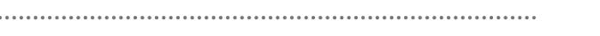
Wambo
Respirable Crystalline Silica Dust
Peter Jandzio, Mining Engineering Manager March, 2023

Slide 2
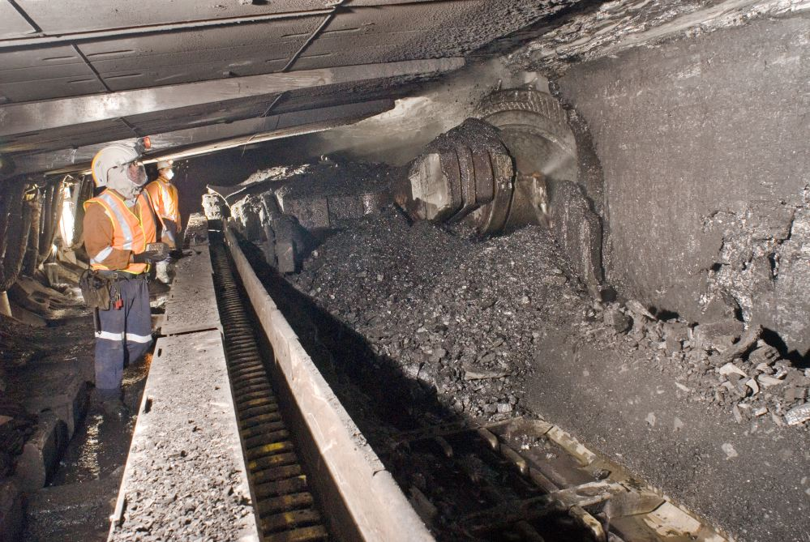
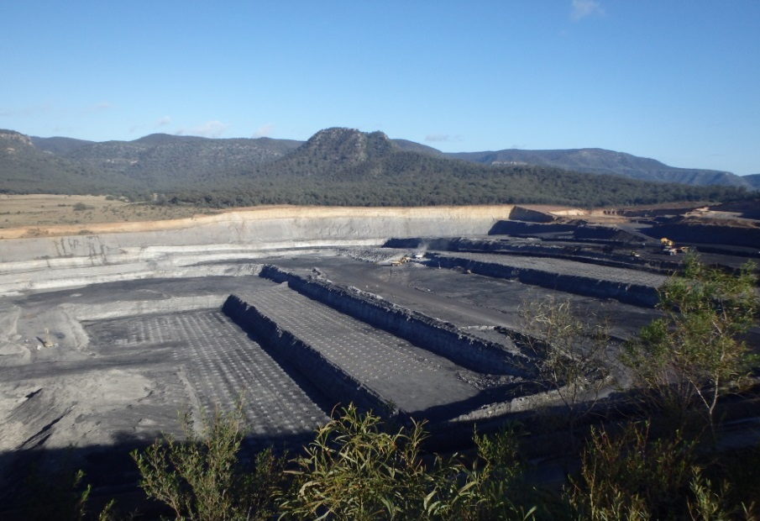
Wambo
Wambo is a combined open-cut and underground mine
Located in the Hunter Valley of New South Wales, Wambo is a well established premium thermal coal mine
Wambo primarily exports to Japan, Korea and China.
In 2022, Wambo complex mined 7.3 million tons of ROM coal.
Wambo employees
  65 Staff
  113 Workforce
  452 UWJV
Wambo UG - Longwall
Wambo Opencut
2

Slide 3
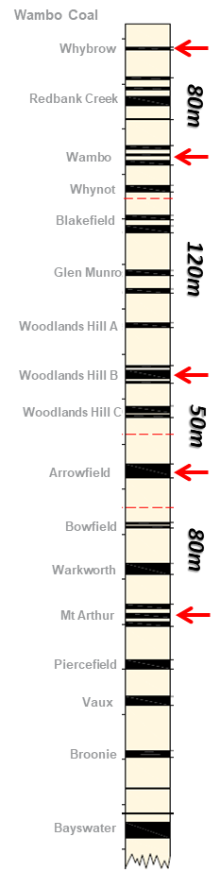
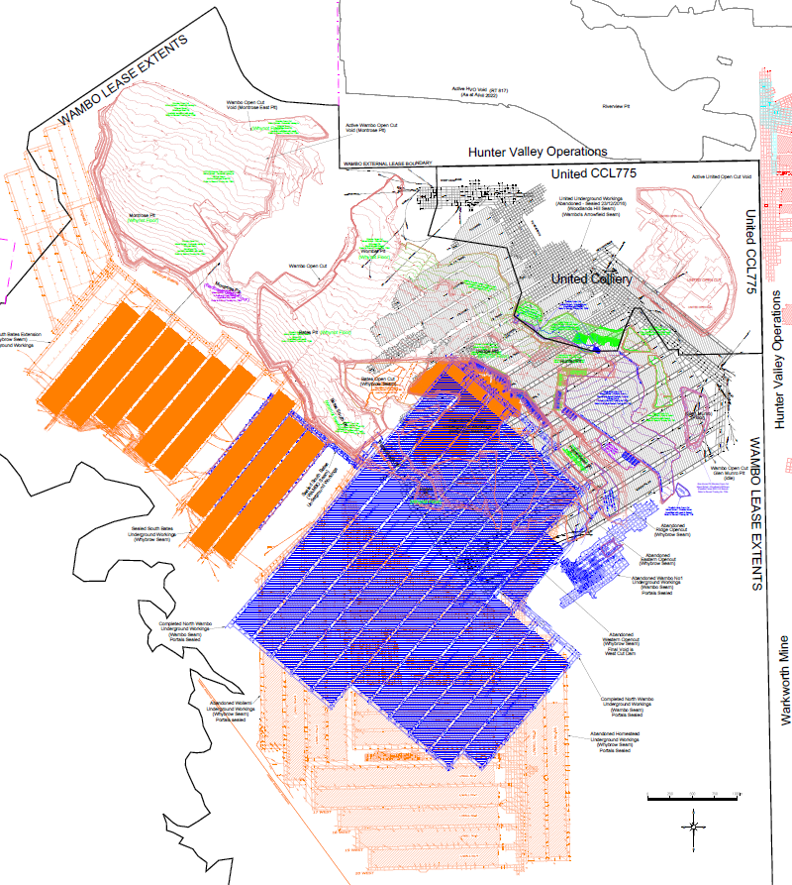
Wambo Underground
Mining History
Multi Seam UG:
Wollemi (Whybrow)
Homestead (Whybrow)
North Wambo (Wambo)
South Bates (Whybrow)
South Bates (Wambo)
South Bates Extended (Whybrow)
United (Glencore) (Arrowfield)
More challenging mining areas with lower margins (Natural progression) – easy coal taken

Slide 4

Wambo UG Airborne Dust Results 2022
Respirable Dust
130 results
0 Exceedances
Respirable Crystalline Silica
125 results
28 Exceedances
Inhalable Dust
38 results
0 Exceedance
168
workers sampled
28
Exceedances
Notes:
Blair Jackson – or delegate

Slide 5
The Problem
Exposing our workers to unacceptable levels of dust which may cause lung disease later in life impacting their quality of life or life expectancy
Repeated respirable silica samples above 0.05 mg/m³
Multiple failures on resamples
Multiple persons failed on single crew
  Entire LW crew above limit
Under the microscope from regulators and coal services
  Interventions

Slide 6
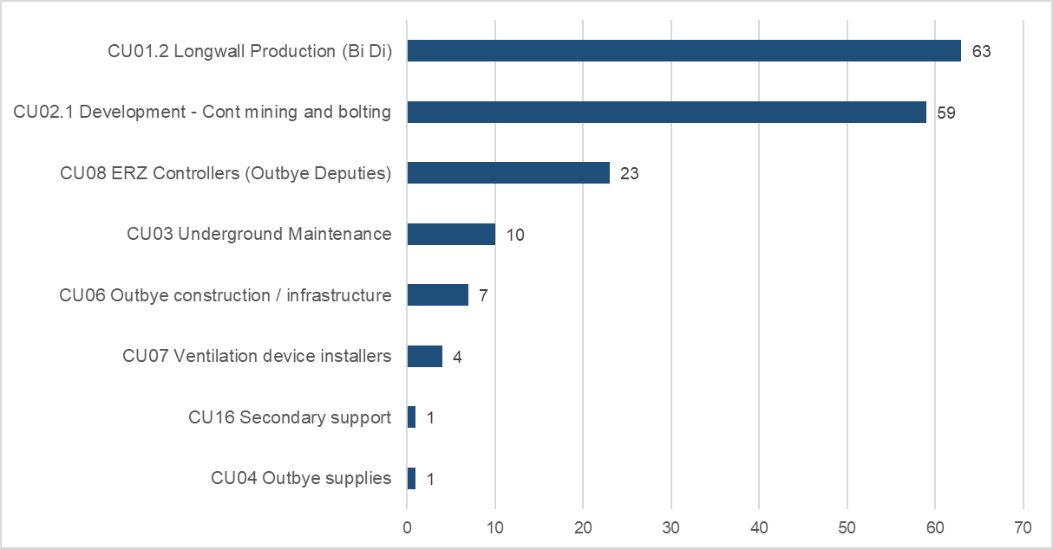
Wambo UG Airborne Dust Results
Workers Sampled 2022
Notes:
Blair Jackson – or delegate

Slide 7
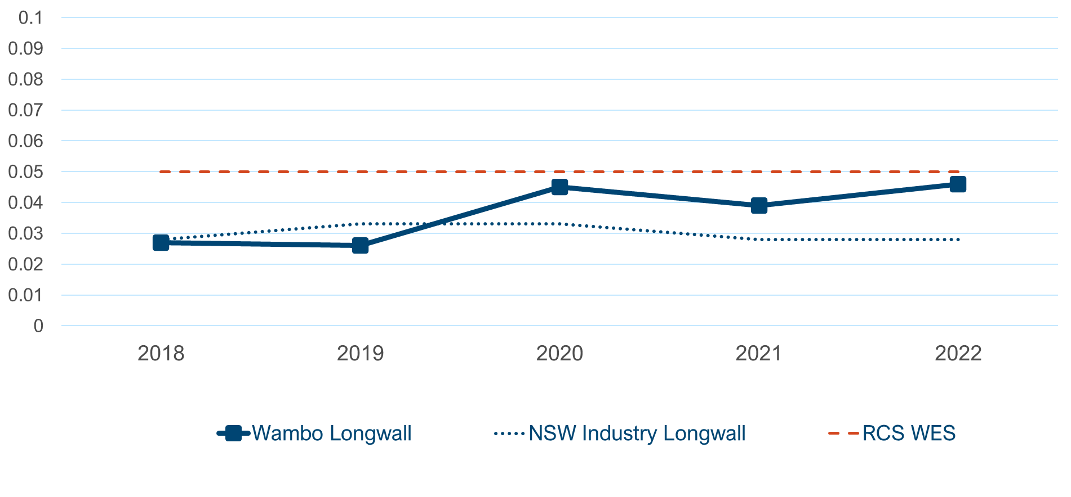
Wambo UG Average Respirable Crystalline Silica Longwall
Notes:
Blair Jackson – or delegate

Slide 8
Information
Based on 2022 data, Recently we have a history of cutting a significant amount of stone
Increased exposures to crystalline silica:
Decreasing seam thickness
Cutting of stone and clay bands
Stone on the AFC/BSL/Crusher
Stone intrusions and faulting
Driving stone roadways – belt chambers & overcasts
Loading out while cutting stone
Handling dry cement-based products
Roadway dust
Float dust
Transfer points
Notes:
Blair Jackson – or delegate

Slide 9
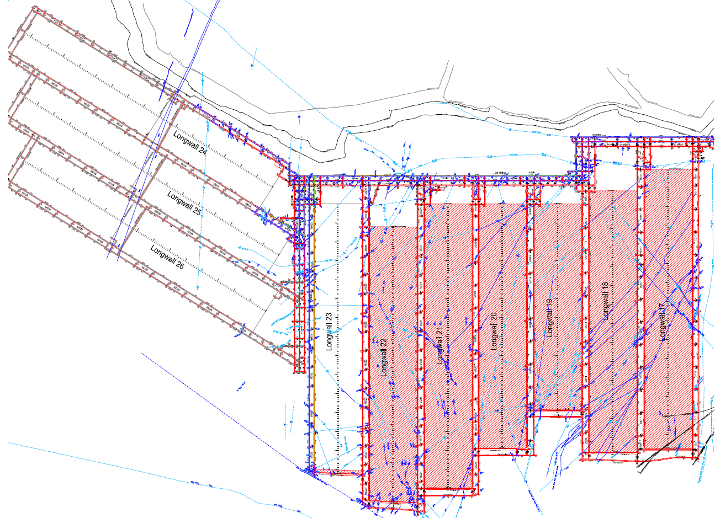
Seam thickness / Dates of mining / Structure
2.6 -3.2m
2.3-2.5m
2.1-2.3m
2.3-2.6m
2.6-2.9m
2018
2022

Slide 10
Mine Working Section - LW
Claystone / Sandstone –
HARD + ABRASIVE
Roof
35.3 – 39.5% silica
0.8m – 1.2m Approx.
A Ply
5.5 – 17.3% silica
Clay Band – 0.3m
B Ply
Working Section – 2.3m – 2.5m
18.0 – 33.5% silica
1m Approx.
4.0 – 12.1% silica
C Ply
Claystone
Floor
11.5 – 32.7% silica

Slide 11
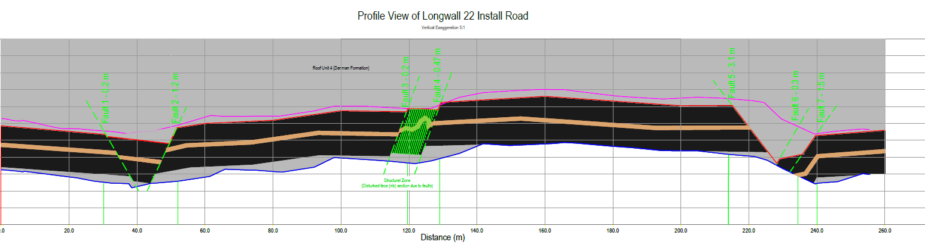
Geology / Structure
Highly structured mining area
  Highly Variable
  Unpredictable
Roof and floor is sometimes cut to grade horizon through faults
Roof graded into gate roads
LW22 face mapping – Fault in TG roof stone required to be cut

Slide 12
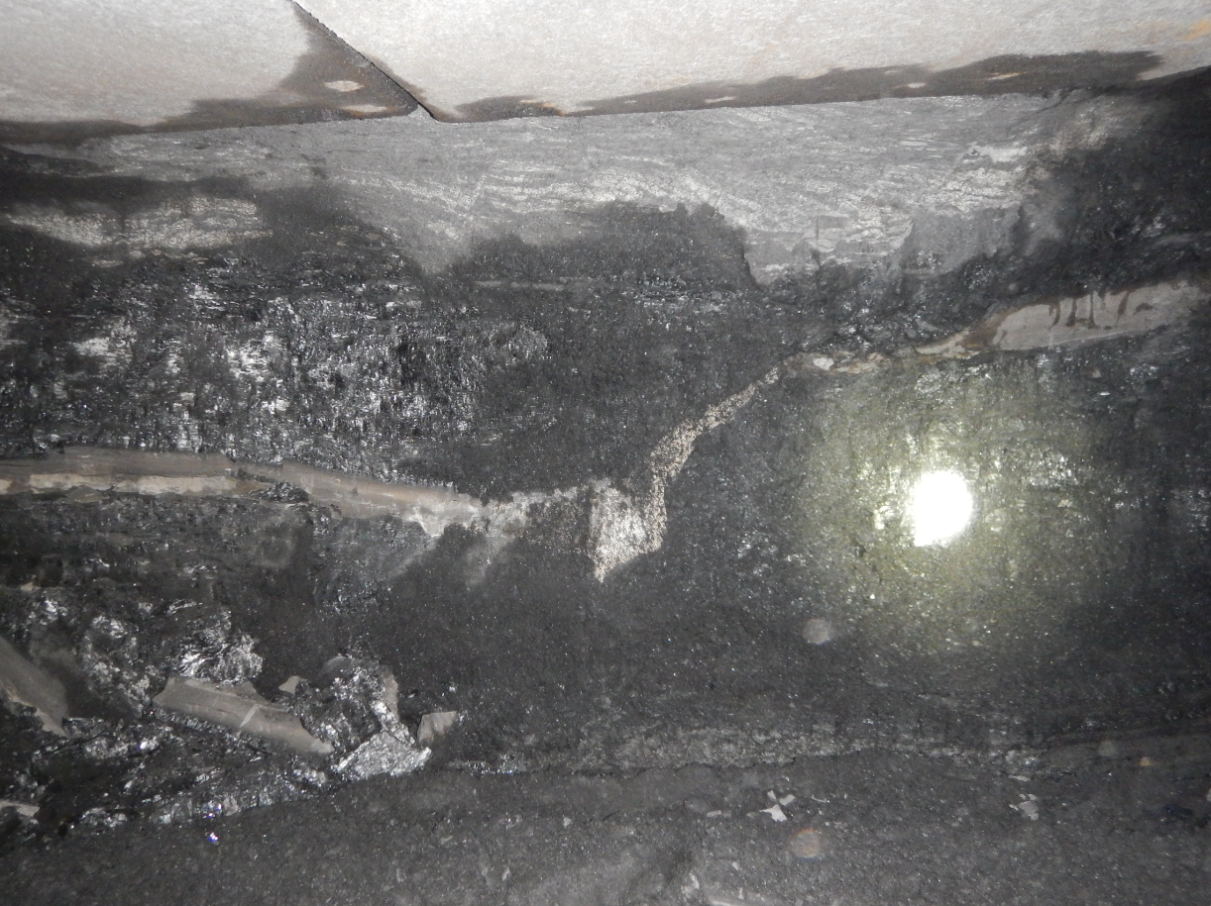
Example – Stone roof intrusion LW22

Slide 13
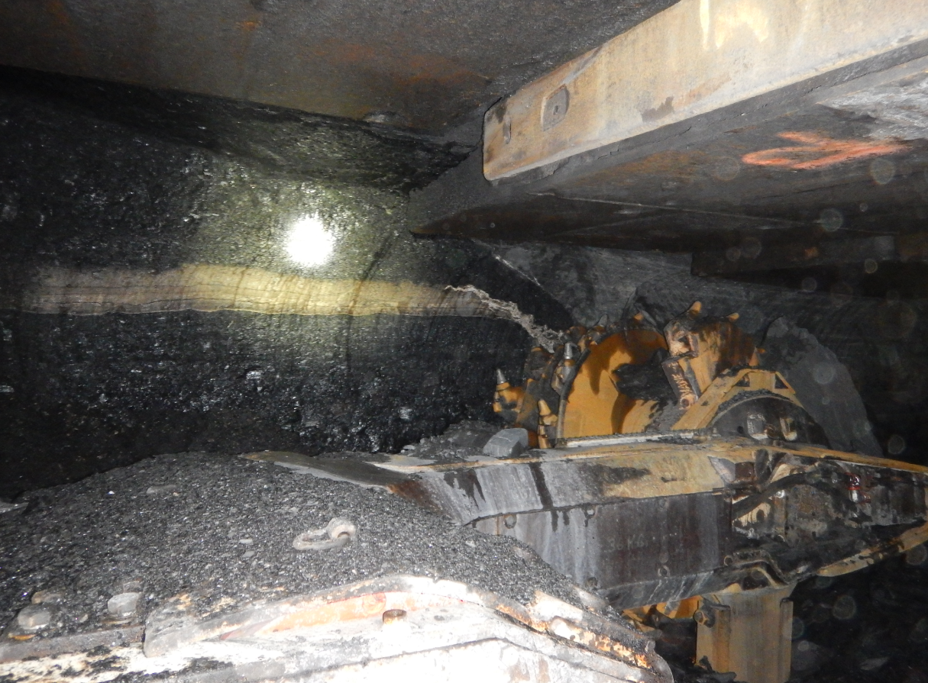
LW Faulting

Slide 14
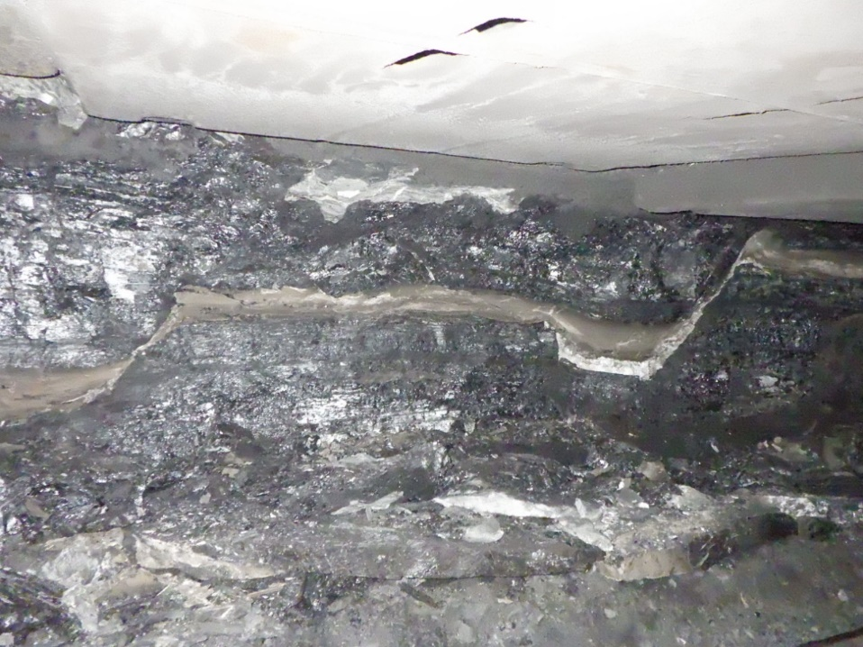
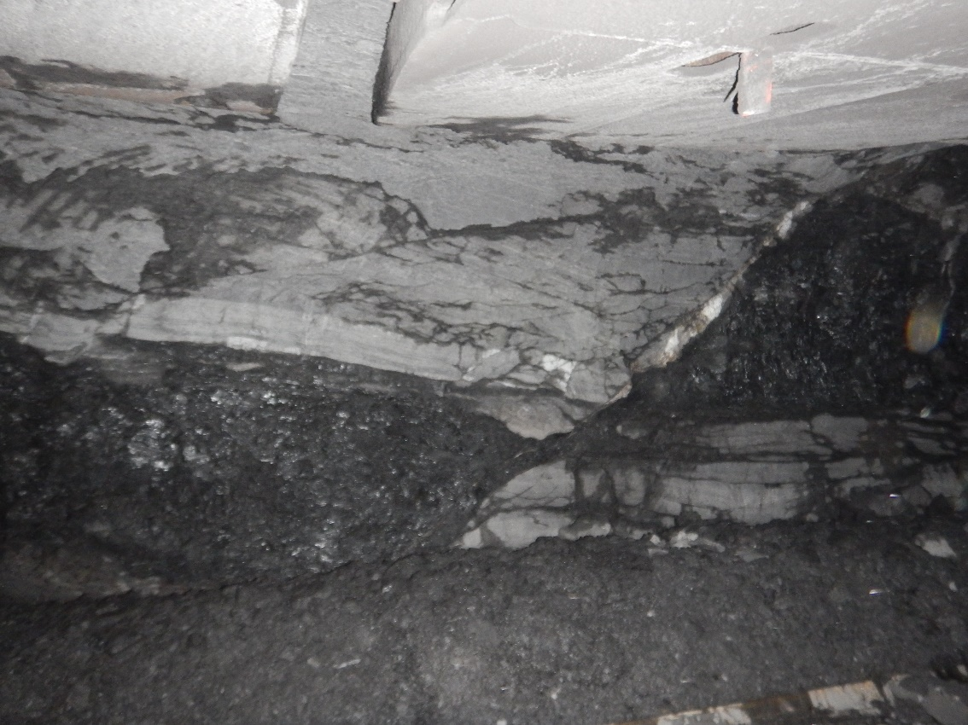
LW Faulting

Slide 15
LW Dust Control Improvements / Actions
Engineering Controls:
Installation of mimic MG DCB – advance 1 + 2 shield from intake side
Homotropal ventilation LW23
Installation of extra BSL / crusher sprays at entry
Installation of pitch steer automation – LW23
Ventilation shaft – under construction
Cone/fog sprays on AFC/BSL interlace
Administration/PPE Controls:
Shiftly dust inspection verification tool
Training more LW operators to allow better rotation
Trialing different operator rotation techniques
Airborne dust TARPs / review of safe standing zones
Cutting horizon plans
Face mapping
Versaflo

Slide 16
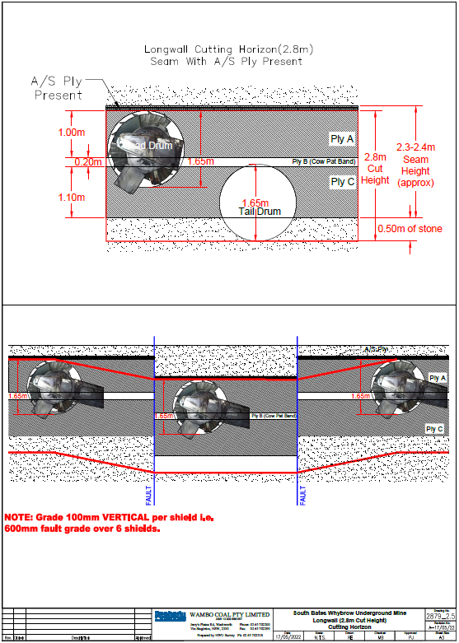
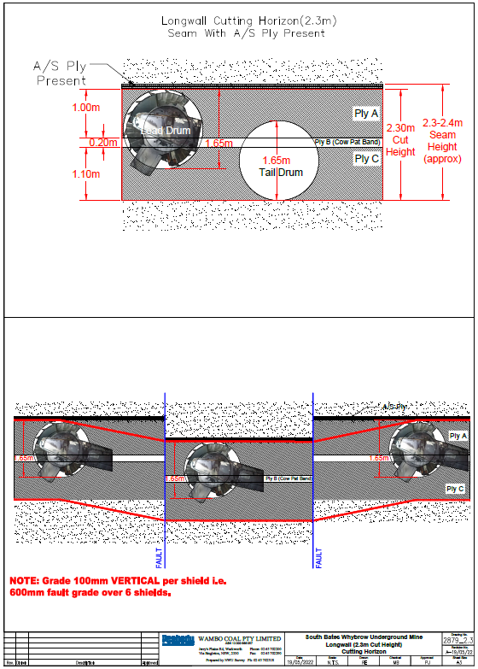
LW22 Cutting horizon

Slide 17
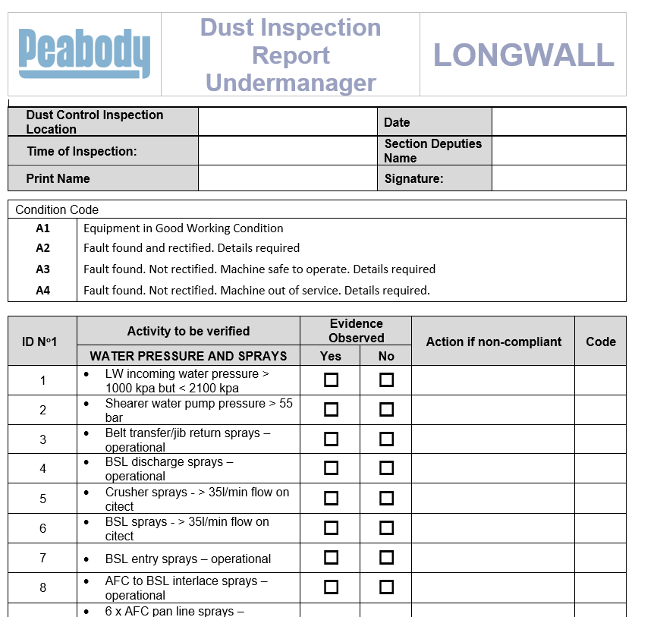
Airborne Dust Control Inspection Tool

Slide 18
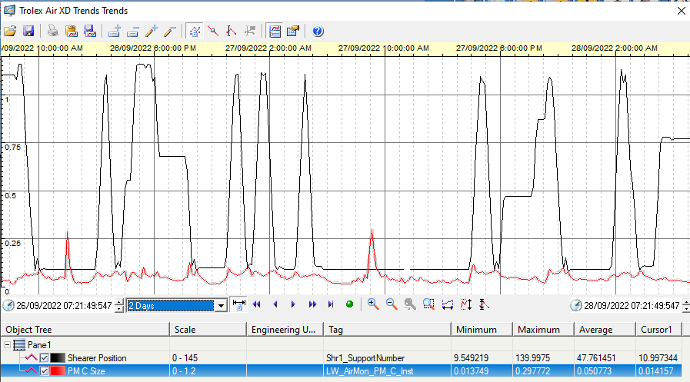
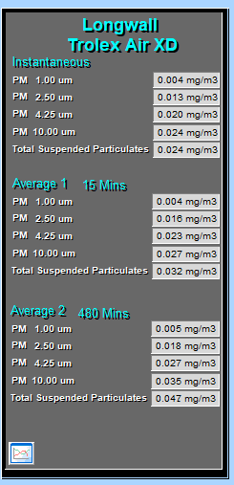
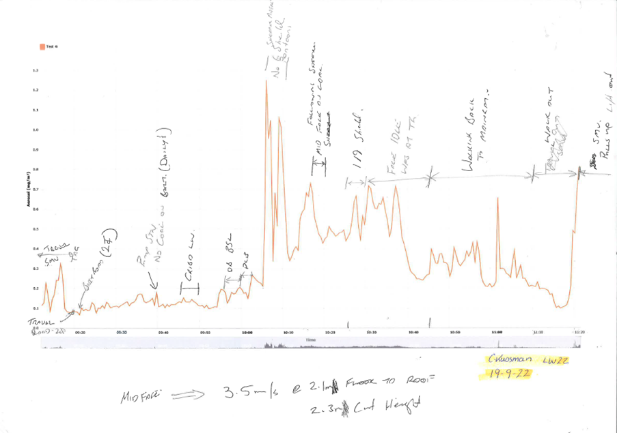
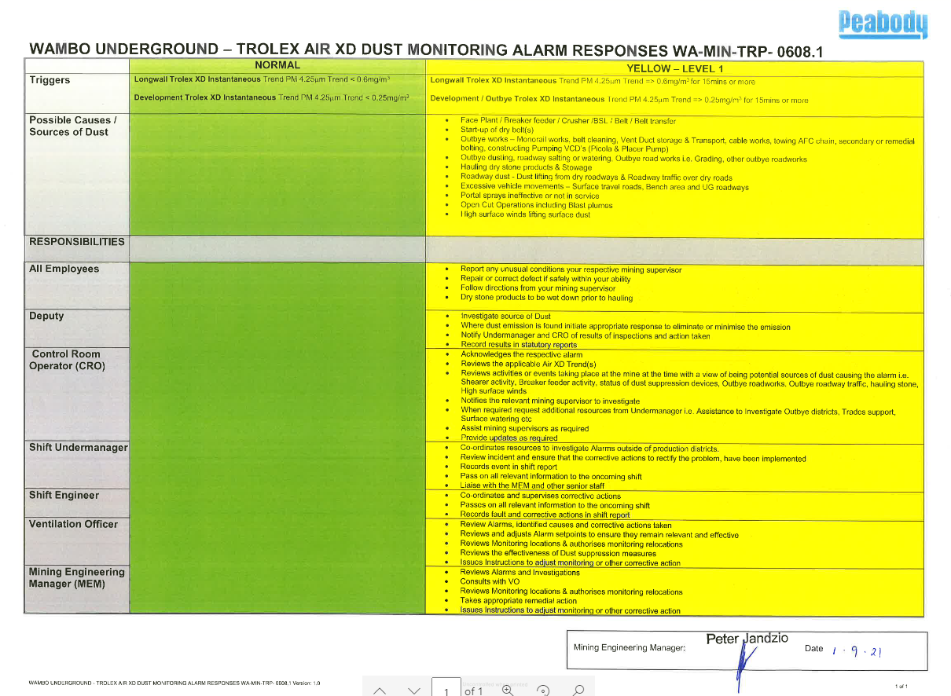
Airborne dust tools used onsite
Air XD
AM520i

Slide 19
Things we do
Report each exceedance, Investigate and implement controls
Airborne dust committee onsite
WHS committee has separate section on airborne dust and results
Maintain an airborne dust action log (Longwall, Dev, O/B and whole of mine)
Sample and verify changes and additional controls using dust monitors
Conduct additional static samples i.e. LW boot end to capture outbye dust when sampling
Systematic approach to ensure control effectiveness
Communicate to workforce regularly

Slide 20
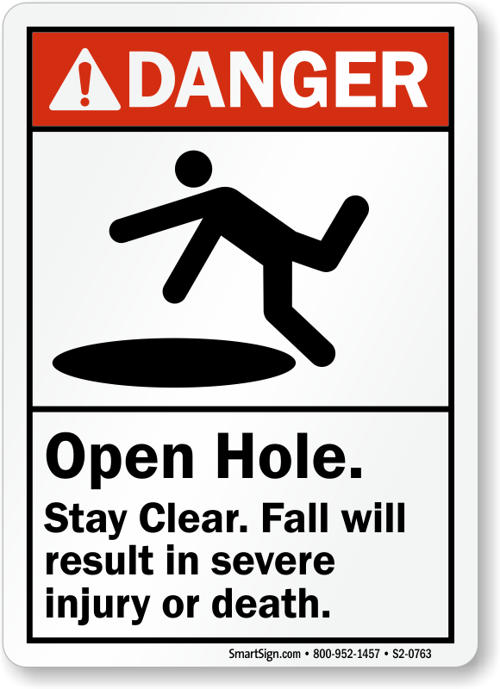
Challenges for a Mine Manager
People
  Getting individuals to care enough about themselves and others about a problem which may occur in the future
  Getting supervisors / engineers engaged and to prioritise hazard
  She’ll be right mate in some instances / Change behaviour
  “They halved the limit!”
  Not a hazard which can easily been seen or immediate impact
  Behavior around ‘passing samples’ when people aren’t watching
Consultation
  So Important, it is a journey
Thorough Investigations
  Delayed – results / roster / Personnel on leave
  Sometimes actions cannot be implemented in time subsequent resample
  Not a definitive cause in some instances / multiple causes cannot be isolated
Continual Education
  Multiple sources for education – Coal Services Technical / Mine Manager / Undermanagers / regulator
Systematic approach
Striving for ALARP

Slide 21
Summary
Seeing some improvement
  Positive results
  People's behavior and attitudes towards airborne dust
Continual journey
No silver bullet – ALL controls need to be working for the lowest exposure
It takes an active effort to manage
We will continue to strive to lowest exposure possible

Slide 22
Questions

