Slide 1
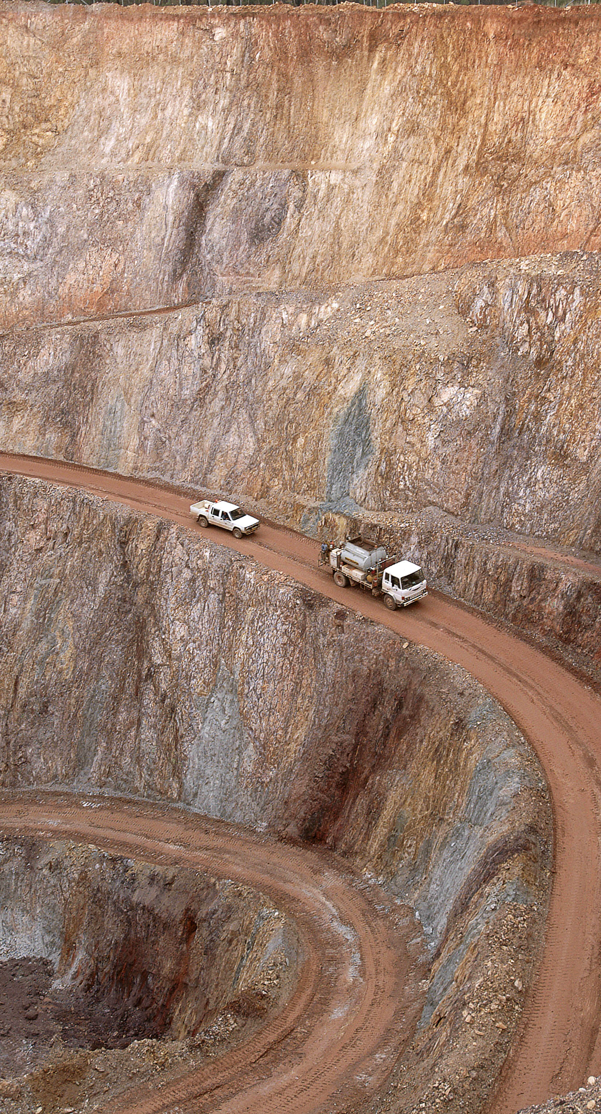
Central Assessment Unit
Underground Coal Mining Engineering Managers Forum
Ben Withers
21 March 2023

Slide 2
08:00 – 16:00 Monday – Friday (excl. public holidays)
CAU operating
16:00 – 08:00 weekdays
Inspector on call
CAU & Mech/Elec Engineering Inspectors
Weekends + public holidays
Principal Inspectors
Outside business hours third party call centre screen the calls.
Escalation process in place if the transferred call is unanswered by an Inspector
Notes:
You will always get an inspector,
It may be from another sector such as small mines or metalliferous
All are experienced and have worked in various areas of the mining industry.
The script used with our third party is based around incidents, if you need to urgently speak with an inspector state it is an urgent matter and insist on being connected.

Slide 3
Dangerous vs High Potential
Work Health and Safety (Mines and Petroleum Sites) Regulation 2022
Duty to notify regulator of certain incidents
(5) In this section—
(a) an event referred to in section 190(1) that would have been a dangerous incident if a person were reasonably in the vicinity at the time when the incident or event occurred and in usual circumstances a person could have been in the vicinity at the time,

Slide 4
Dangerous vs High Potential
Work Health and Safety (Mines and Petroleum Sites) Regulation 2022
Duty to notify regulator of certain incidents
(5) In this section—
(a) an event referred to in section 190(1) that would have been a dangerous incident if a person were reasonably in the vicinity at the time when the incident or event occurred and in usual circumstances a person could have been in the vicinity at the time,
Notes:
If something falls and brushes the person, but they are uninjured, they are in the vicinity
If first aid treatment is received, they are in the vicinity

Slide 5
Injuries
An incident is considered serious if:
an injured worker is admitted to hospital immediately
This includes where admission is delayed as the worker is referred to a different hospital where specialist treatment is not available
a fractured to any bone other than the hand or foot.
The ankle is not part of the foot
The wrist is not part of the hand
If an injury escalates
please notify when you become aware
Notes:
To clarify some confusion and common mistakes we see around dangerous incidents.

Slide 6
Reporting issues
A person was standing on the chassis of a truck prime mover about to position a safety prop under the raised trailer when he slipped & fell approx. 1.5m.
Injuries included – right shoulder, contusion to right elbow & lower back soreness.
Should have been reported as a Clause 179(a) (v) – fall from height
Reported as a Clause 128 & no scene preservation.

Slide 7
A haul truck lost control on a wet road & collided with a stationary haul truck.
Reported as a Clause 179 (a) (xiii) – a collision – Correct.
Reported to MEM within 5mins, but not reported to RR for another 3hrs & 45mins.

Slide 8
You are not on site 24/7
But you must have documented systems in place to ensure compliance with the Act & Regs.
Do your “Incident Reports” ask the question “is this a notifiable” & “does this scene need to be preserved”?
Where do your supervisors have to go to look up the list of “Notifiables”? Are they listed in the “Incident Report Books”?
What training & assessment has been given to your supervisors on your expectations?

Slide 9
Justification
It happened at 1am, but I didn’t want to wake you, so I waited until 7am. We man the 1300 814 609 the full 24/7.
I wanted to fully investigate the incident before ringing you. Ring & tell us what you already know. Then ring back with more information to update us.
The supervisor didn’t realise it was a “notifiable”.
I wasn’t sure if it was a Clause 179 or just a Clause 128. Well ring & discuss it. It is still your decision, but at least we are aware of it.

Slide 10
Remember the Media
This day & age with all the current forms of “media” news travels very fast.
If an ambulance is called TV & Radio may pick it up.
If the police are called, they ring either us or Safework with an “event number”.
If Safework receives a call, they ring us with an “event number”.
The workforce or public will ring to make sure we are aware of what has happened.

Slide 11
Notifier aware
3 date fields in an incident:
The Incident date & time
The date and time the notifier became aware the incident was notifiable
The date and time the regulator was notified
System generates non-compliance for those reported outside of the legislated requirements
Notes:
For the date and time that the regulator was notified, this is automatically generated if the mine load the incident directly to the portal or when the call was received for those notified via the hotline.

Slide 12
Notifier aware
9 March 2023
Certificate received stating that the worker will be unfit for suitable duties for 7 days
10 March 2023
Notification completed on the portal
4/10/2022
Worker strains shoulder
7 March 2023
Worker undergoes surgery
Incident date | 4 October 2022
Date notifier became aware | 9 March 2023
Notified to Regulator | 10 March 2023
Notes:
The point when the mine is aware the worker will be unfit for 7 days is when the notifier became aware.
If you have other staff members who typically complete these notifications, we encourage you to ask them to call up and have this explained. We are more than happy to help clarify with anyone notifying incidents.

Slide 13
Additional information needed
Any updates to incident status
Witness statements
Photos of the incident scene
Injured workers
Workers still trapped or unaccounted for
Changes to incident scene/status
Statement from workers involved
Statement from witnesses
Statement from responders
Photos of area
Close ups photos of failure point
Any video footage available
Notes:
Key information we require to make initial assessment and manage our immediate response,
Photos – please provide photos that give context, not simply a failed hose or end of a conveyor idler. Start further out. We require photos to validate the description, we have had small fires reported and when the photos received there is no bonnet left and cab half burnt off a truck.
Witness statements – if there is an injured worker we understand that their statement is usually delayed. Please provide other workers and responders statements

Slide 14
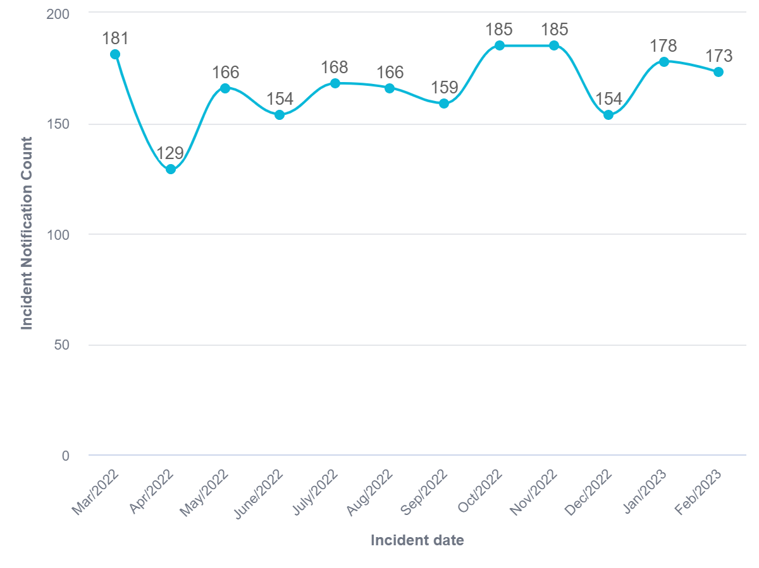
12 month incident trend
Notes:
This is all incidents notified across all sectors,
1998 total
167 incidents per month average

Slide 15
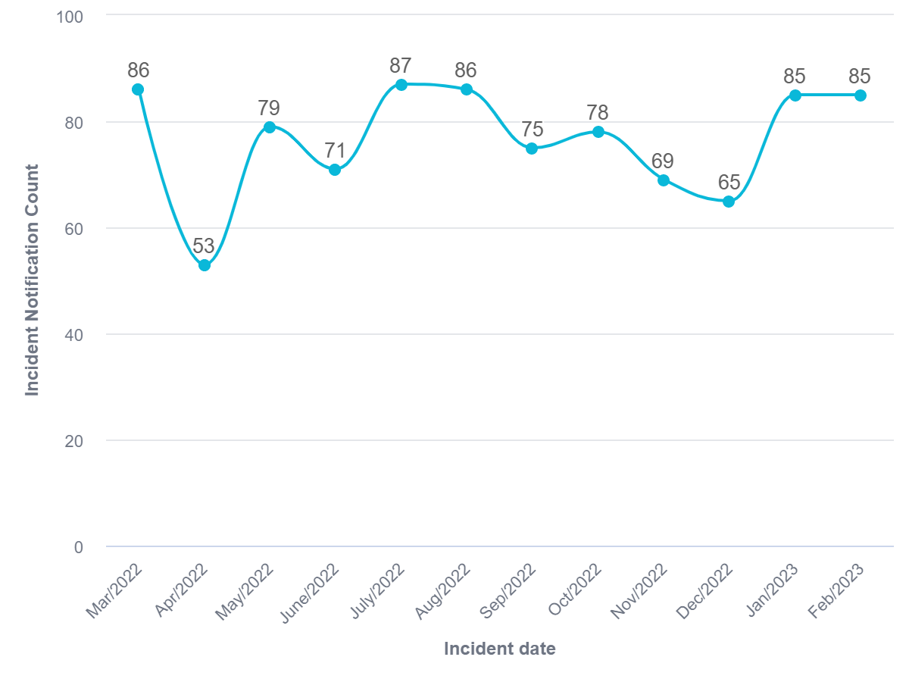
12 month incident trend – Underground Coal
Notes:
919 incidents for the 12 month period,
Average of 77 per month.

Slide 16
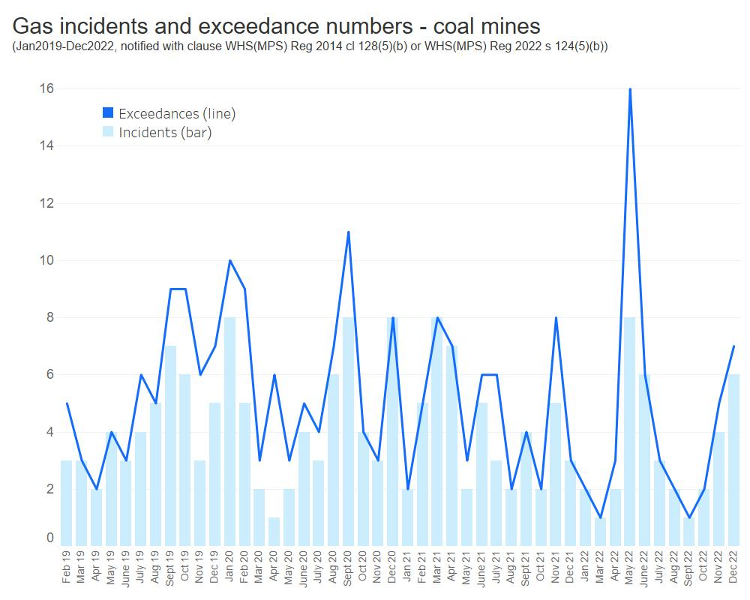
Gas exceedances
Notes:
Notifications of methane concentrations in the general body of air greater than 2%
The bar graph represents the number of incident notifications, the line is the total exceedances reported.
Regarding the peak of 8 notification in May 2022, there were 6 mines reporting incidents. 3 mines reported a single 1 exceedance, 1 mine reported 2 exceedances, 1 mine reported 4 and another 5. 1 mine reported 3 individual exceedances.

Slide 17
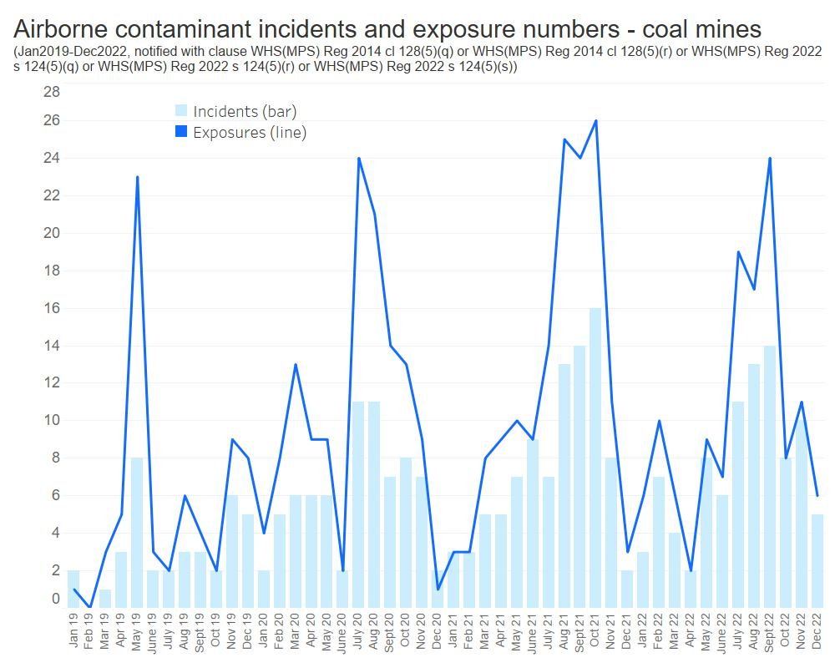
Worker exposed to airborne contaminants
Notes:
Like the previous graph, The bar graph represents the number of incident notifications, the line is the total exceedances reported.
In 2022 we employed an Occupational Hygienist.
When a notification is made it is reviewed by an inspector in the CAU and then by the hygienist.
Particular attention is paid when a re-sample exceeds the exposure limit.

Slide 18
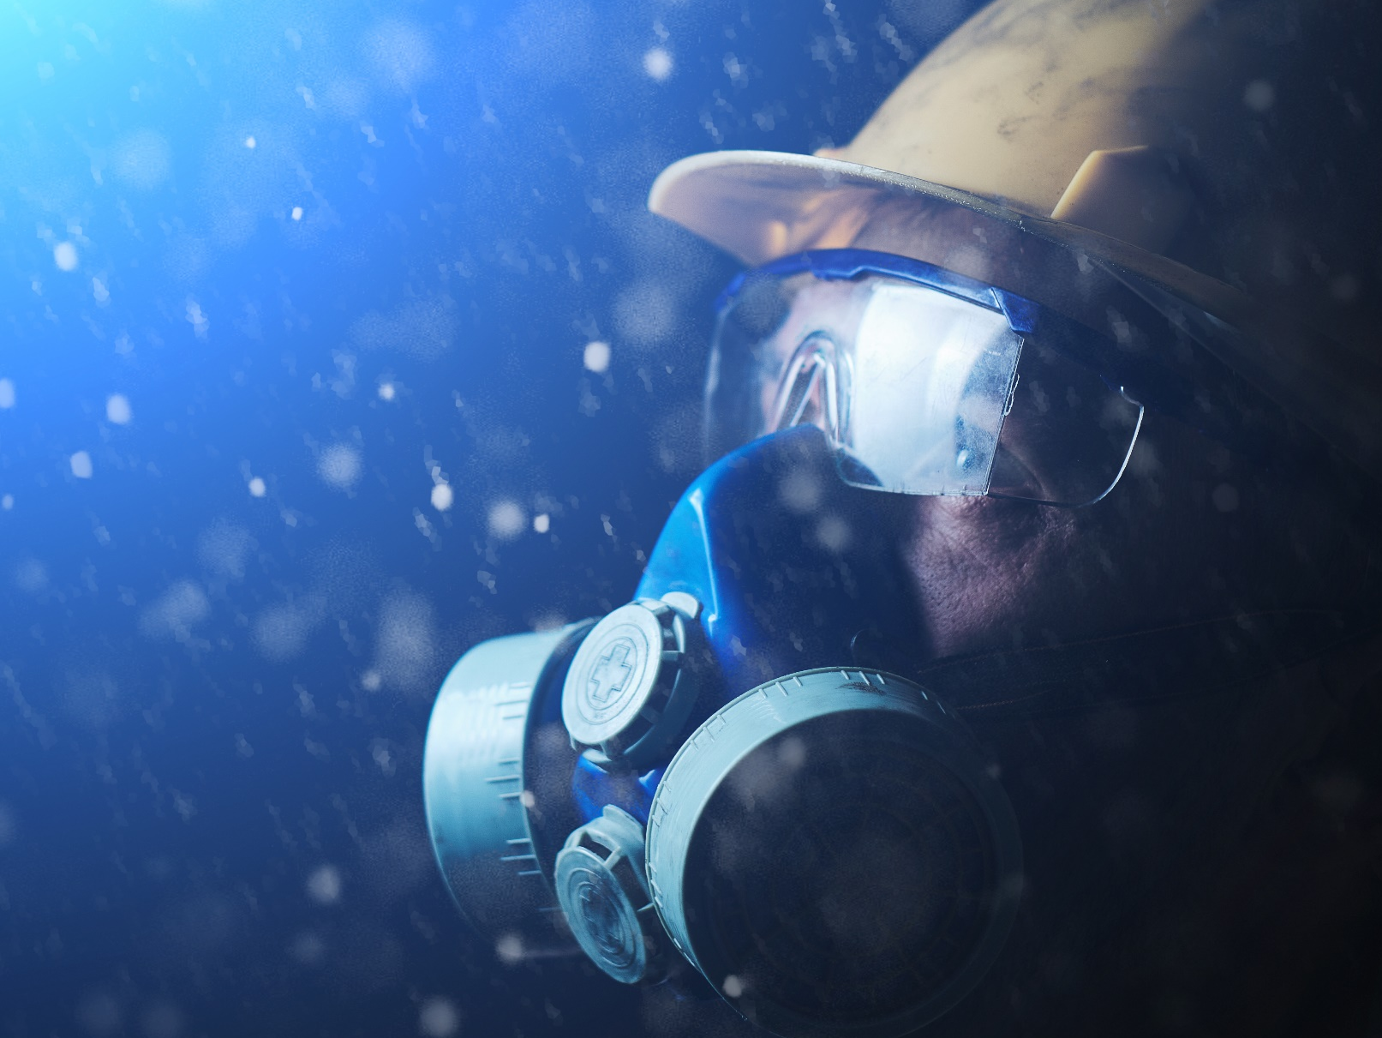
Exposure to airborne dust
Exceedance tab added to the incident notification
Wide range of investigation standards
Improvements in:
Position of people
Exclusion of workers from dusty environments
Opportunities:
Maintenance of control measures
Consideration of all factors when determining no go zones
Notes:
1 September 2022 legislation changes also introduced additional exceedance data, this will look at seg groups, exposure levels and time weighted exposure limits.
This will allow data interrogation and trending and comparisons.
From assessments conducted we have seen an improvement in positions of people and no go zones implements.
Industry still needs to focus on maintenance of control measures, blocked or isolated sprays, dust curtains damaged.
Had an incident where no go zones were set for the longwall focused on dust, piece of coal 0.5m coal block hit the shearer, slid down the arm and struck an operator. Still need to consider Fly rock and strata failure.

Slide 19
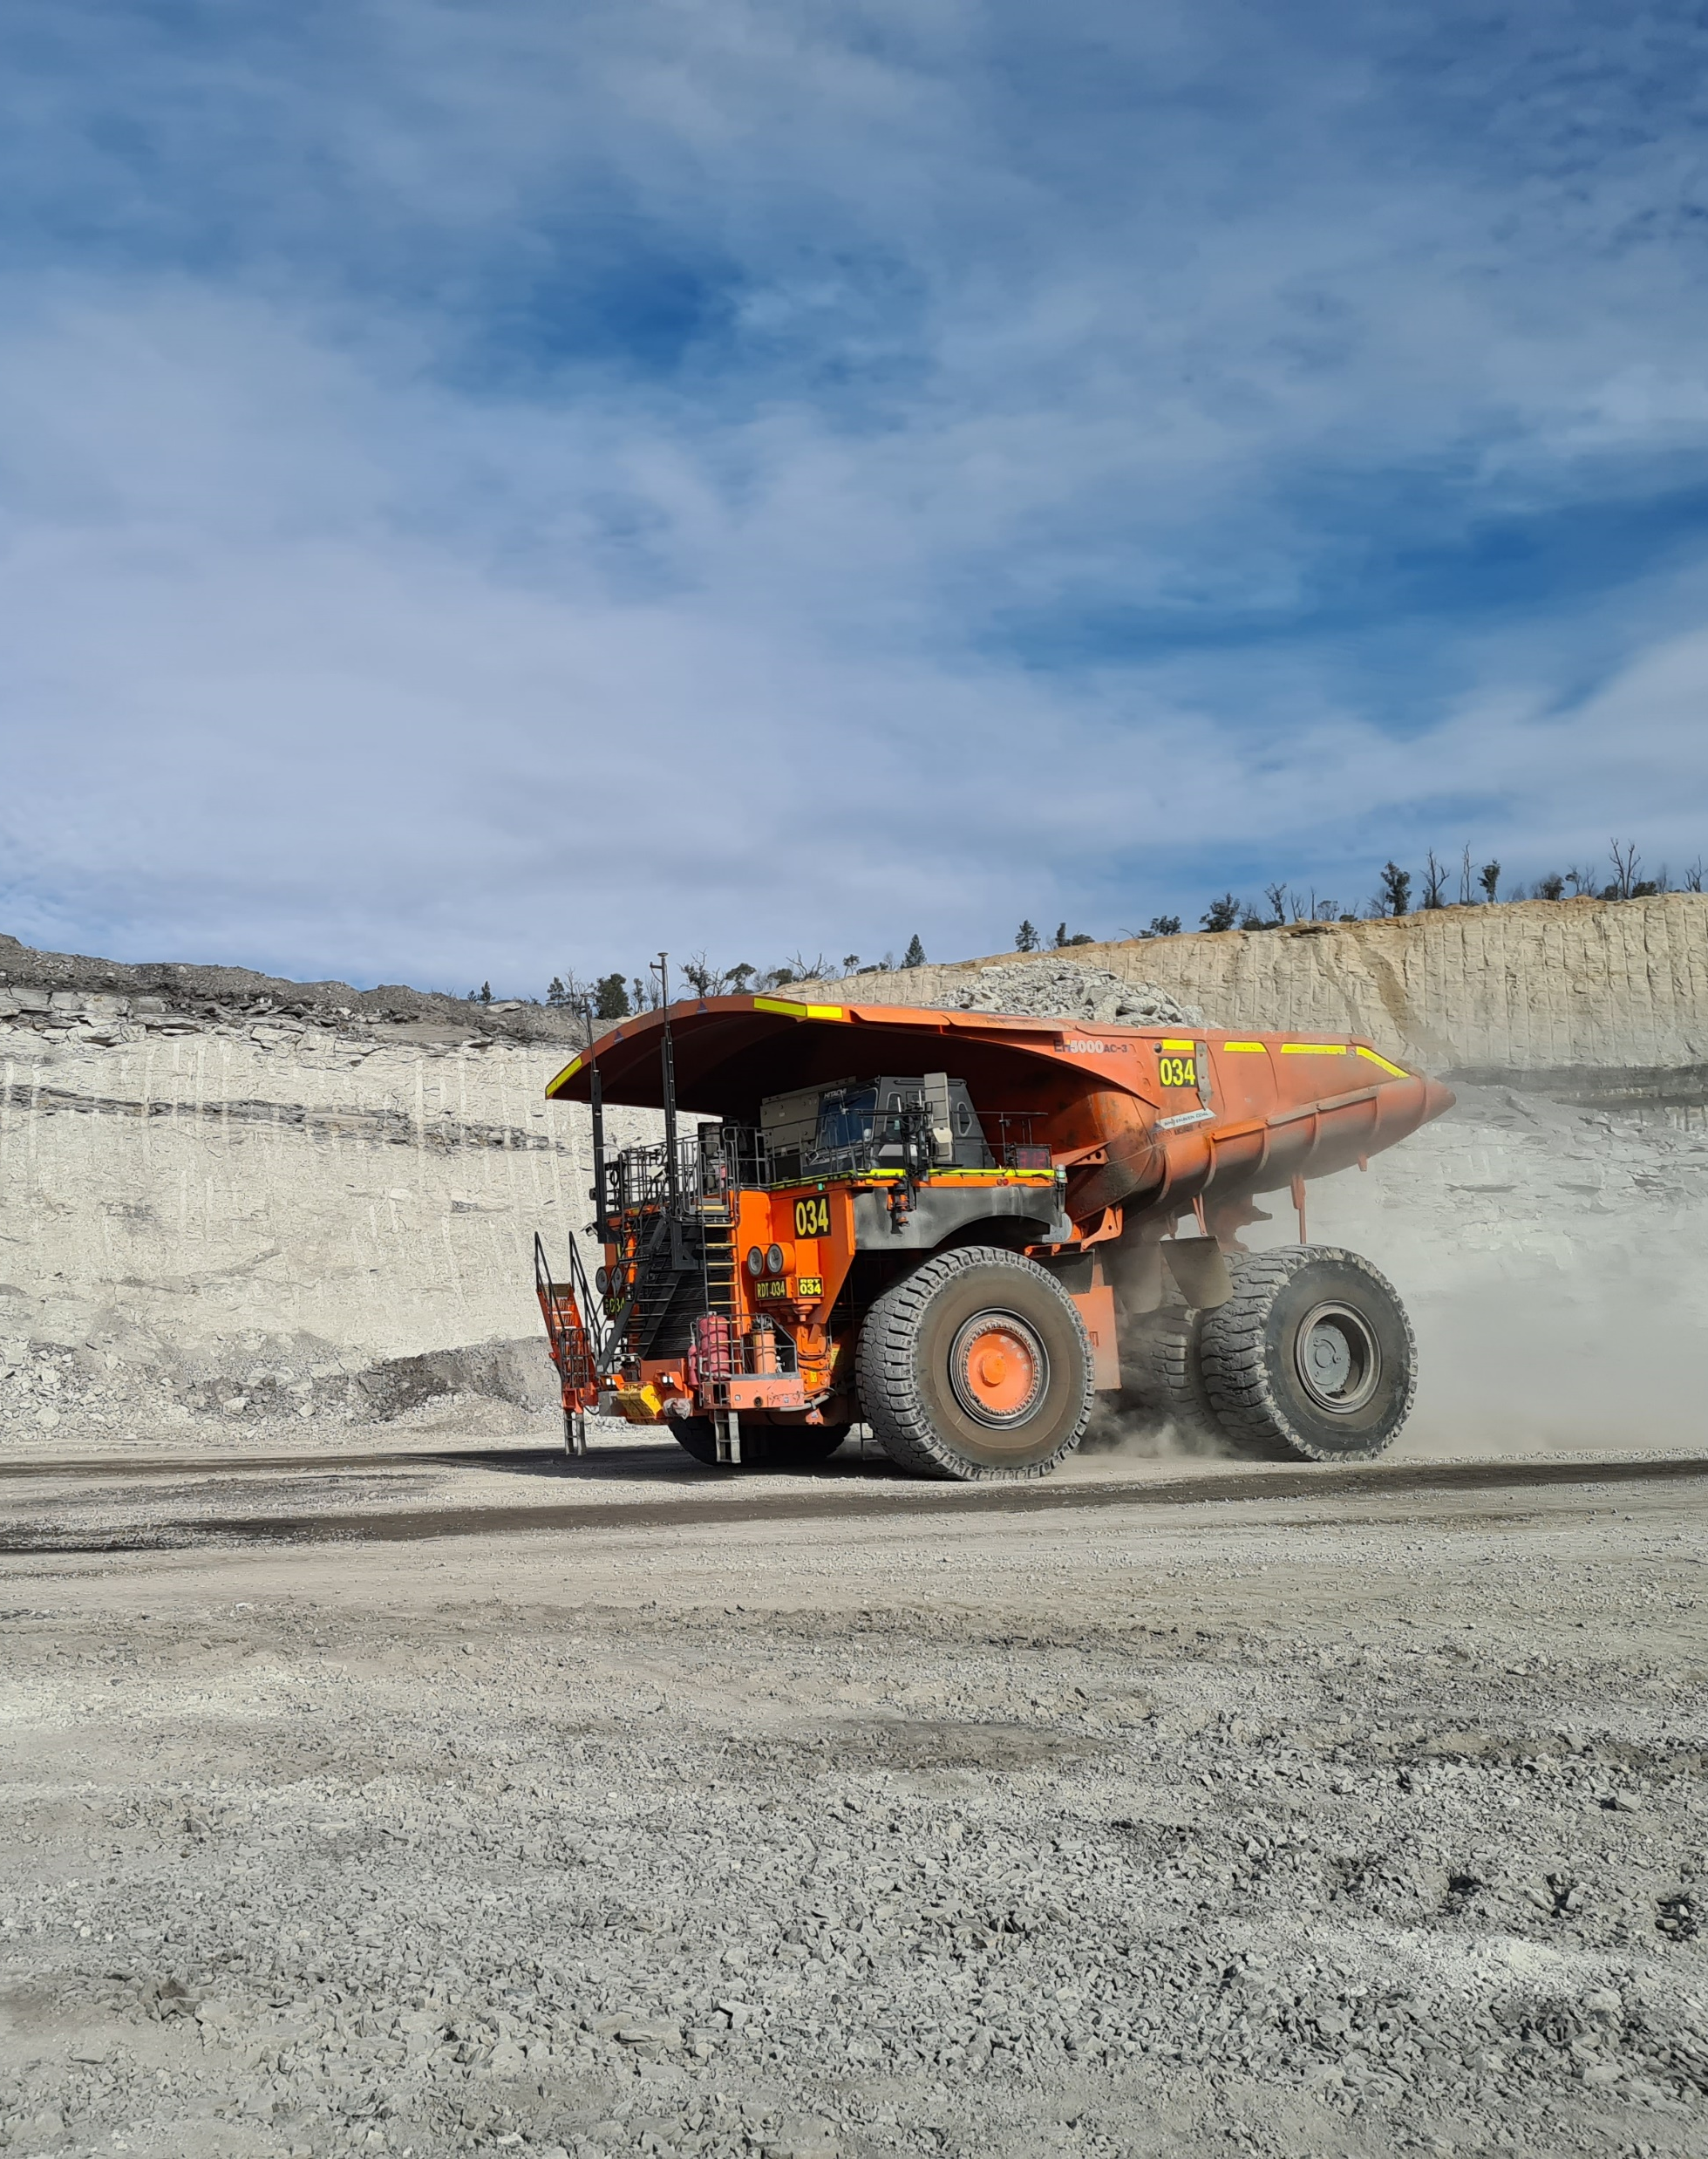
Trainee operators
Seeing an increase in incidents notifed relating to trainee operators.
What triggers a trainee’s assessment to go solo?
What does drive to conditions mean to a trainee?
What follow up assessments are conducted after a trainee is appointed to operate solo?
Is there a cap on how many trainees on a shift?
Is their adequate supervision and mentoring capability on shift?
Notes:
Are trainees assessed to go solo after a set amount of shifts or at the recommendation of a trainer?
Recently following an incident, the investigation revealed a trainee being assessed yet every entry in their log book was ticked as not yet ready to be assessed.

Slide 20
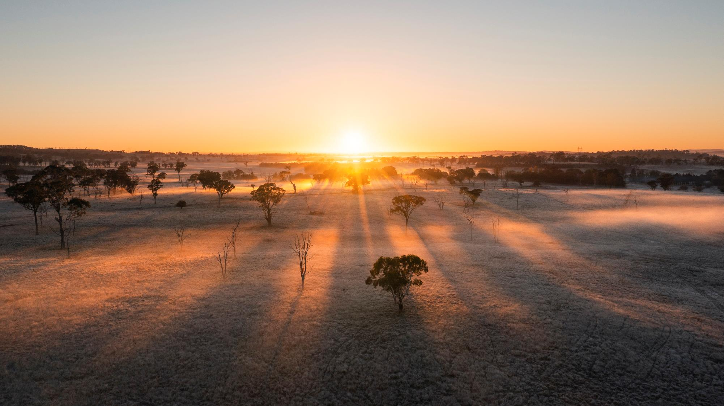

CHOOSE A SLIDE STYLE FROM
Home tab
New Slide
Choose layout
If layout goes awry, select Reset
TEXT
There are 5 levels of formatted text available.
Please move between text levels using the increase/decrease button on the menu above.
CHANGE SLIDE BACKGROUND/COLOUR
Design Menu
Format Background
Select colour from palette OR
Picture or Texture Fill
Find image
REPLACE IMAGE IN SHAPE OR ON PAGE
Right click on image
Change Picture
Select your image
OR
Delete the image
Click on icon
Find the new image
TO REPOSITION IMAGE WITHIN SHAPE
Click on image
Picture Format menu
Click on Crop button dropdown
To fit the whole image inside select FIT
To use only a portion select FILL then crop, move or resize image to show properly within shape.
ADD/CHANGE FOOTER
Insert Menu
Header & Footer
Tick to activate/Untick to remove
Change text
Resources Regulator
Department of Regional NSW
Image, pullout text and caption
Image caption here

