Slide 1
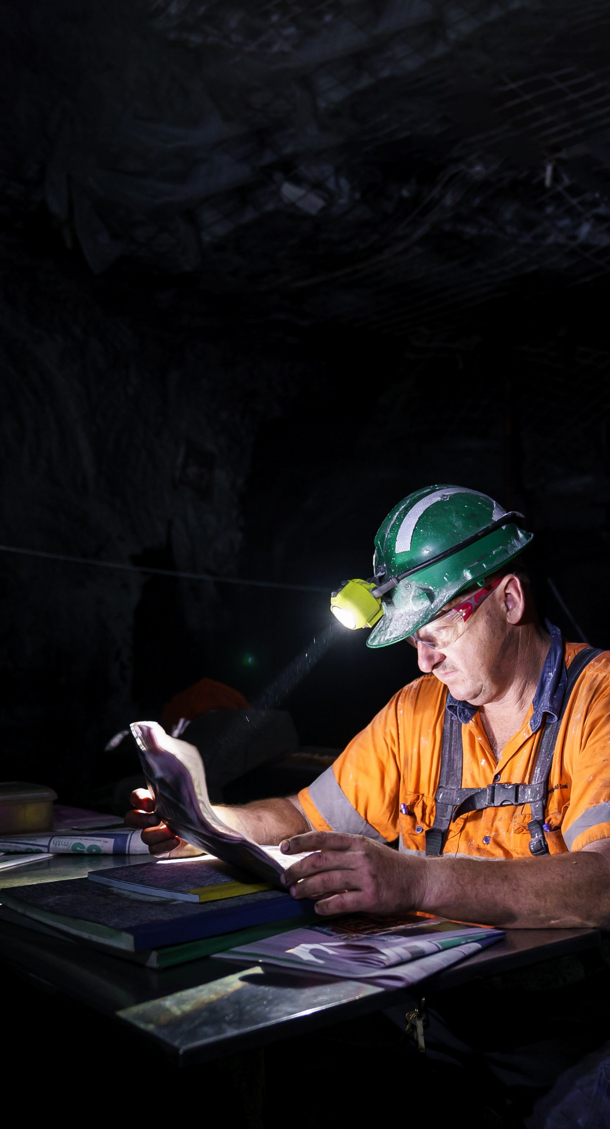
Plant registration forum
9 March 2023

Slide 3
Emergency procedures
Resources Regulator
  Department of Regional NSW
Please note the emergency exits in the room.
Beep beep – prepare to evacuate and await further instruction from emergency wardens.
Whoop whoop – a warden will instruct us to evacuate via the closest exit.
Emergency evacuation point is located outside in the carpark.
Please do not use the lifts in the case of an emergency.

Slide 4


Slide 5



Other housekeeping
Resources Regulator
  Department of Regional NSW
Just a reminder that this meeting is not being recorded. What happens in the room, stays in the room.
Please keep your phones on silent.
Please take this opportunity to network and participate in discussions, specifically during the Around the Grounds session later today.

Slide 6
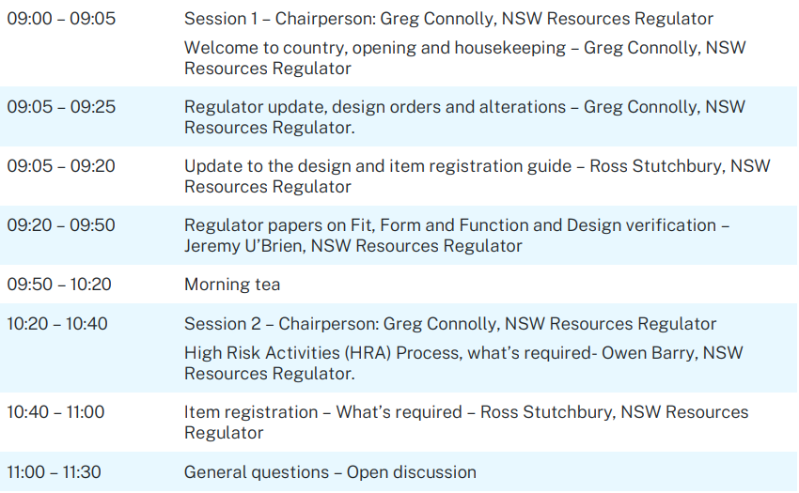
Agenda

Slide 7
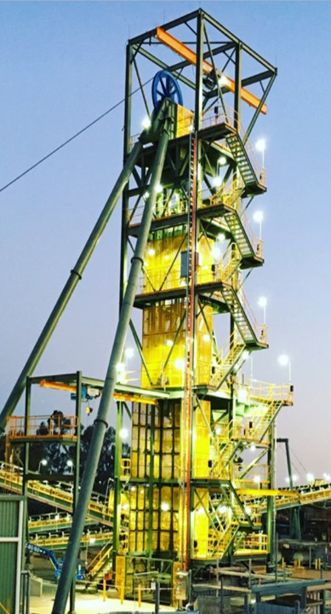
Mechanical Engineering Update
Greg Connolly
Principal Inspector Mechanical Engineering
March 2023

Slide 8
Presentation summary
CHOOSE A SLIDE STYLE FROM
Home tab
New Slide
Choose layout
If layout goes awry, select Reset
TEXT
There are 5 levels of formatted text available.
Please move between text levels using the increase/decrease button on the menu above.
CHANGE SLIDE BACKGROUND/COLOUR
Design Menu
Format Background
Select colour from palette OR
Picture or Texture Fill
Find image
REPLACE IMAGE IN SHAPE OR ON PAGE
Right click on image
Change Picture
Select your image
OR
Delete the image
Click on icon
Find the new image
TO REPOSITION IMAGE WITHIN SHAPE
Click on image
Picture Format menu
Click on Crop button dropdown
To fit the whole image inside select FIT
To use only a portion select FILL then crop, move or resize image to show properly within shape.
ADD/CHANGE FOOTER
Insert Menu
Header & Footer
Tick to activate/Untick to remove
Change text
In this presentation I will cover: Industry engagement from the regulator Technical reference guide updates Design order review Implementation of design orders Legislation changes NSW government gazette Changes to high risk activities Incidents How to contact the mechanical engineering team
Notes:
Today we will cover a bit of ground covering
Updates to guidelines
Gazette notices
Changes to process

Slide 9

Industry engagement
CHOOSE A SLIDE STYLE FROM
Home tab
New Slide
Choose layout
If layout goes awry, select Reset
TEXT
There are 5 levels of formatted text available.
Please move between text levels using the increase/decrease button on the menu above.
CHANGE SLIDE BACKGROUND/COLOUR
Design Menu
Format Background
Select colour from palette OR
Picture or Texture Fill
Find image
REPLACE IMAGE IN SHAPE OR ON PAGE
Right click on image
Change Picture
Select your image
OR
Delete the image
Click on icon
Find the new image
TO REPOSITION IMAGE WITHIN SHAPE
Click on image
Picture Format menu
Click on Crop button dropdown
To fit the whole image inside select FIT
To use only a portion select FILL then crop, move or resize image to show properly within shape.
ADD/CHANGE FOOTER
Insert Menu
Header & Footer
Tick to activate/Untick to remove
Change text
The mechanical team continues to engage with industry through various events to include:
        Mechanical engineers meeting for open cut coal, underground coal and metalliferous mines – twice a year.
        Annual Mechanical Engineering Safety Seminar
        Metalliferous Industry Safety and Health Engagement Forum – twice a year
        Design registration holders forum, and
        Licenced facility forum
Notes:
The Mechanical Team coordinate a number of meetings, forums and seminars each year
Coming up in March are:
22nd MetEx mechanical forum
28th Surface mechanical forum
30th UG mechanical forum
The Mechanical Engineering Safety Seminar is on 2nd and 3rd August
The licenced facility forum is in November

Slide 10
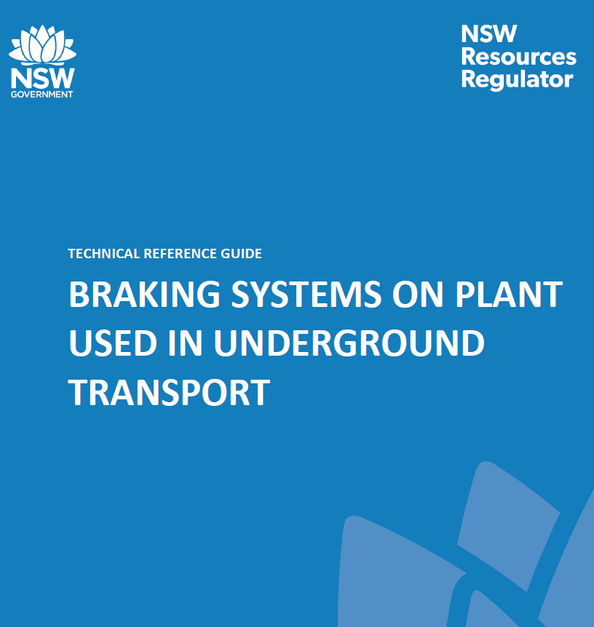
Technical reference guides
CHOOSE A SLIDE STYLE FROM
Home tab
New Slide
Choose layout
If layout goes awry, select Reset
TEXT
There are 5 levels of formatted text available.
Please move between text levels using the increase/decrease button on the menu above.
CHANGE SLIDE BACKGROUND/COLOUR
Design Menu
Format Background
Select colour from palette OR
Picture or Texture Fill
Find image
REPLACE IMAGE IN SHAPE OR ON PAGE
Right click on image
Change Picture
Select your image
OR
Delete the image
Click on icon
Find the new image
TO REPOSITION IMAGE WITHIN SHAPE
Click on image
Picture Format menu
Click on Crop button dropdown
To fit the whole image inside select FIT
To use only a portion select FILL then crop, move or resize image to show properly within shape.
ADD/CHANGE FOOTER
Insert Menu
Header & Footer
Tick to activate/Untick to remove
Change text
When the Regulators Mining Design Guidelines (MDG’s) are reviewed they will be converted to Technical Reference Guides (TRG’s)
The following TRG’s have been published in the past 12 months:
        Winding systems for small gemstone mines
        Braking systems on plant used in underground transport
        Non-metallic materials for use in underground coal mines and reclaim tunnels in coal mines
Notes:
Technical reference guides are being rolled out as we review the old Mining design guidelines
They aim to provide an example of what needs to be considered to achieve best industry practice
In October 2022 TRG Winding systems for small gemstone mines replaced MDG 42.1, and
TRG non metallic materials replaced MDG 3608
In July 2022 TRG Braking systems for UG plant replaced MDG 39

Slide 11
Technical reference guides
CHOOSE A SLIDE STYLE FROM
Home tab
New Slide
Choose layout
If layout goes awry, select Reset
TEXT
There are 5 levels of formatted text available.
Please move between text levels using the increase/decrease button on the menu above.
CHANGE SLIDE BACKGROUND/COLOUR
Design Menu
Format Background
Select colour from palette OR
Picture or Texture Fill
Find image
REPLACE IMAGE IN SHAPE OR ON PAGE
Right click on image
Change Picture
Select your image
OR
Delete the image
Click on icon
Find the new image
TO REPOSITION IMAGE WITHIN SHAPE
Click on image
Picture Format menu
Click on Crop button dropdown
To fit the whole image inside select FIT
To use only a portion select FILL then crop, move or resize image to show properly within shape.
ADD/CHANGE FOOTER
Insert Menu
Header & Footer
Tick to activate/Untick to remove
Change text
The following will be going out for targeted industry feedback:
        Stockpiles and reclaim tunnels (formerly MDG 28)
      The following will look to be updated in the next 12 months:
        MDG 35.1 Drilling and bolting UG coal mines
        TRG for braking systems
        MDG 3007 Hydraulic safety – will be merged with MDG41.
Notes:
Industry comment have come back in for TRG Stockpiles and Reclaim tunnels, and these will be reviewed. They include:
Consider access and repairs to broken down mobile plant on stockpiles
Location and maintenance of rescue equipment
MDG 35.1 is basically bolting rigs for strata support where drilling is a part of the strata support installation process
MDG 3007 will be merged into TRG Fluid power as well as Technical reference TR420 for staple lock fittings. This will consolidate the Fluid Power guideline.

Slide 12
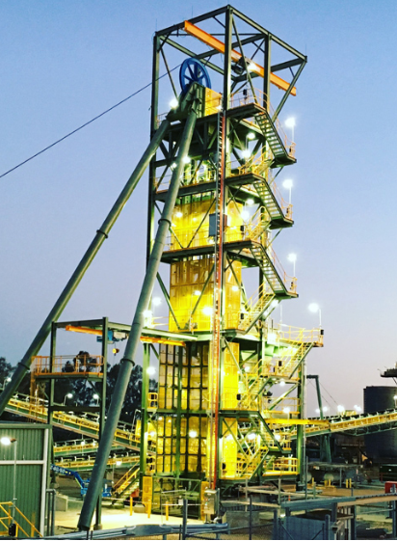
Resources Regulator
Department of Regional NSW
Design order review
        The independent review of Work Health and Safety (Mines and Petroleum Sites) Act identified opportunities for the simplification of the design registration processes.
        From the review the design orders have been updated to include alterations and the allowance of an equivalent level of safety.
        This change allows for the alteration to parts of the design without bringing the entire design up to the new standard.
        All these changes have now been implemented
Notes:
One aspect of the review is alteration with equivalent level of safety.
It allows for the alteration to parts of the plant design where there is NO impact on the safety of the remaining plant
Incremental upgrade

Slide 13
Resources Regulator
Department of Regional NSW
Design order review
The following design orders have changed:
        Braking system
        Breathing apparatus
        Canopies on continuous miners
        Conveyor belting
        Detonators design order
        Diesel engine systems
        Explosive powered tools
        Powered winding systems
Notes:
This comes from the Gazettes issued from September last year
With the new legislation came the need to update previous gazettes
TBS
Design requirements
Alteration
Testing and performance requirements to comply with TRG transport braking systems
Conveyor belting
UG coal must be FRAS
Testing and performance
Test facility NATA or similar
DES
In UG coal mines diesel engines must be FpDES or ExDES
Advise where it does not fully comply
Assess alterations
Testing and performance requirements, including emissions
Requirements of test facility
Powered winding systems
Must be designed in accordance with the TRG
Part 1 for design
Part 2 or 3 for design and construction depending on being a drift or shaft winder
Part 4 ropes
Part 5 control systems performance and requirements
Where it does not fully comply then you must specify standard or principles used
Alterations that affect health and safety must be assessed

Slide 14

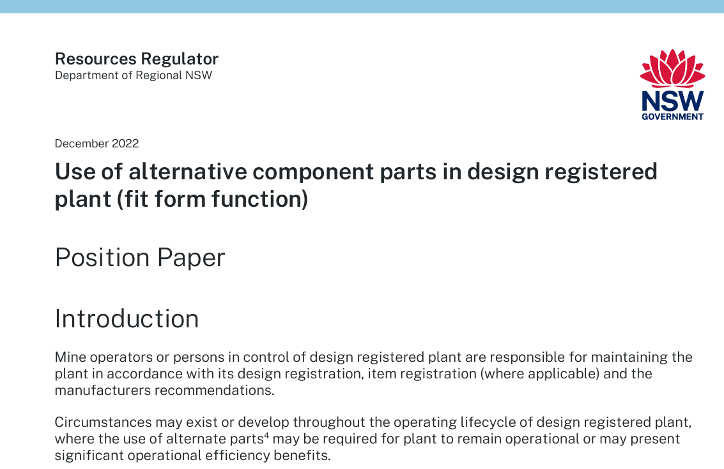
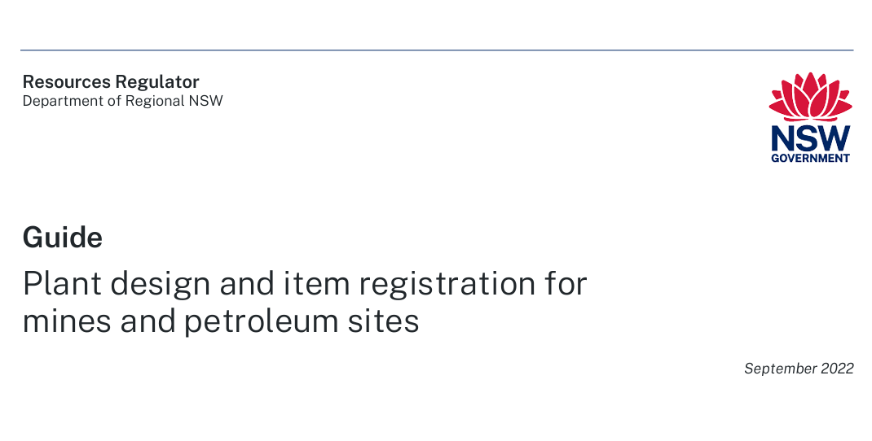
Implementation
        A new guide has been developed and published to our website to cover off on the changes.
        The guide replaced the current fact sheets for design and item registration.
        A position paper has been also released on the use of alternative component parts in design registered plant.
Notes:
Ross will talk about the process for design and item registration
Jeremy will talk about the use of alternative components in design registered plant

Slide 15
Legislation changes
CHOOSE A SLIDE STYLE FROM
Home tab
New Slide
Choose layout
If layout goes awry, select Reset
TEXT
There are 5 levels of formatted text available.
Please move between text levels using the increase/decrease button on the menu above.
CHANGE SLIDE BACKGROUND/COLOUR
Design Menu
Format Background
Select colour from palette OR
Picture or Texture Fill
Find image
REPLACE IMAGE IN SHAPE OR ON PAGE
Right click on image
Change Picture
Select your image
OR
Delete the image
Click on icon
Find the new image
TO REPOSITION IMAGE WITHIN SHAPE
Click on image
Picture Format menu
Click on Crop button dropdown
To fit the whole image inside select FIT
To use only a portion select FILL then crop, move or resize image to show properly within shape.
ADD/CHANGE FOOTER
Insert Menu
Header & Footer
Tick to activate/Untick to remove
Change text
The Work Health and Safety (Mines and Petroleum Sites) Regulation 2022 commenced on 1 September 2022.
The remade regulation includes a change in drafting style to reference ‘sections’ instead of ‘clauses’. In addition, the remade regulation includes the following reforms but not limited to:
        Exhaust emissions and fuel standards in underground coal mines
        High-risk activities
        Registration of plant design and items of plant (hoists)
Notes:
Sections instead of clauses
Owen Barry will discuss high risk activities
Hoists relates to Gemstone mines

Slide 16
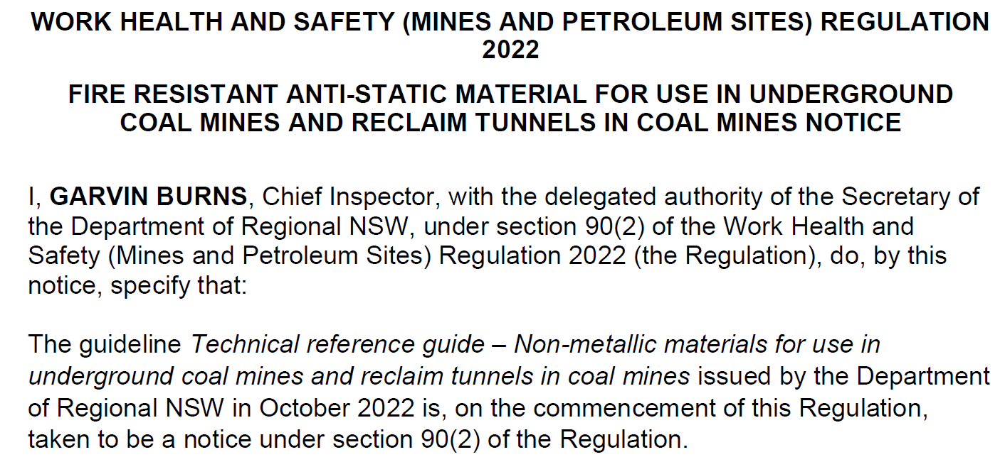
NSW Government Gazettal notices
NSW government gazette n2023-0027 was published under section 90(2) of the Work Health and Safety (Mines and Petroleum Sites) Regulation 2022 on the 11 January 2023 for the technical reference guide – Non metallic material for use in underground coal mines and reclaim tunnels.
(3) The mine operator of a coal mine must ensure an item of plant specified in a notice under this section is not used at the mine unless it has been tested and certified in accordance with the notice.
Notes:
Gazette 27 was implemented to fill in gaps controlling the use of non metallic materials

Slide 17
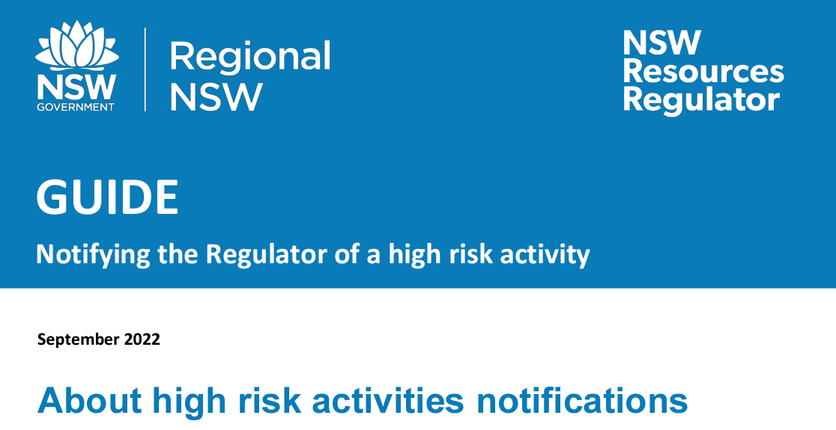
High-risk activities
(HRA’s)
Booster fans and winding systems
CHOOSE A SLIDE STYLE FROM
Home tab
New Slide
Choose layout
If layout goes awry, select Reset
TEXT
There are 5 levels of formatted text available.
Please move between text levels using the increase/decrease button on the menu above.
CHANGE SLIDE BACKGROUND/COLOUR
Design Menu
Format Background
Select colour from palette OR
Picture or Texture Fill
Find image
REPLACE IMAGE IN SHAPE OR ON PAGE
Right click on image
Change Picture
Select your image
OR
Delete the image
Click on icon
Find the new image
TO REPOSITION IMAGE WITHIN SHAPE
Click on image
Picture Format menu
Click on Crop button dropdown
To fit the whole image inside select FIT
To use only a portion select FILL then crop, move or resize image to show properly within shape.
ADD/CHANGE FOOTER
Insert Menu
Header & Footer
Tick to activate/Untick to remove
Change text
The operator of a mine site must now submit a HRA through the regulators online portal when:
        Commissioning a booster fans or winding systems
        Recommissioning after the original design has been altered of above.
This is an online form and must include the information listed in section 35 notification of high risk activities, Schedule 3, Part 1, section 3 winding systems and Schedule 3, Part 3, section 25 Booster fans.
A guide on notifying the regulator of a high risk activity can be found on our webpage.
Notes:
HRA for us is generally related to booster fans and winding systems, although we have looked at them for hot works in the hazardous zone
It is now an online form, and a guide is available.
Much of this will be covered by Owen after morning tea.

Slide 18
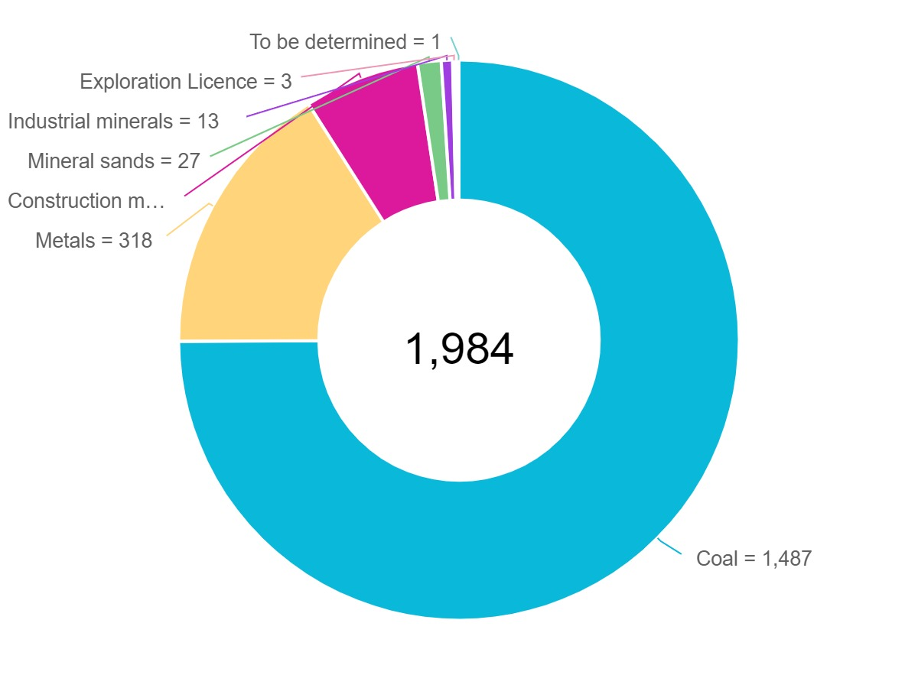
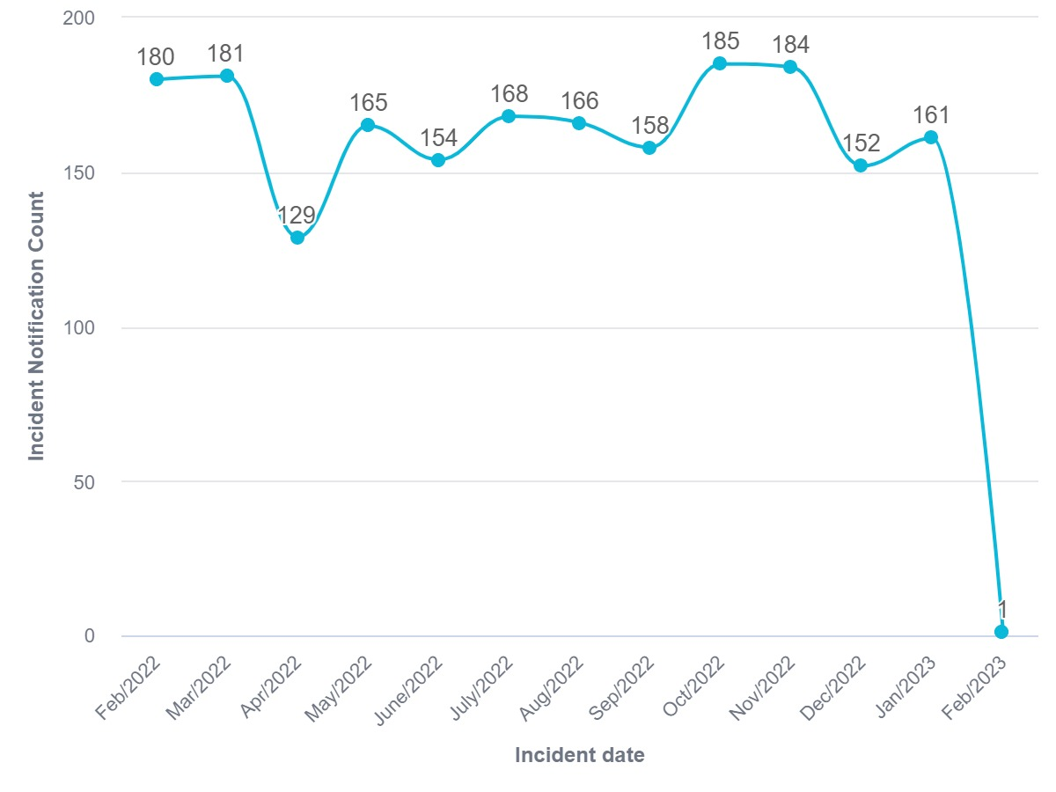
Incidents – Total last 12 months
CHOOSE A SLIDE STYLE FROM
Home tab
New Slide
Choose layout
If layout goes awry, select Reset
TEXT
There are 5 levels of formatted text available.
Please move between text levels using the increase/decrease button on the menu above.
CHANGE SLIDE BACKGROUND/COLOUR
Design Menu
Format Background
Select colour from palette OR
Picture or Texture Fill
Find image
REPLACE IMAGE IN SHAPE OR ON PAGE
Right click on image
Change Picture
Select your image
OR
Delete the image
Click on icon
Find the new image
TO REPOSITION IMAGE WITHIN SHAPE
Click on image
Picture Format menu
Click on Crop button dropdown
To fit the whole image inside select FIT
To use only a portion select FILL then crop, move or resize image to show properly within shape.
ADD/CHANGE FOOTER
Insert Menu
Header & Footer
Tick to activate/Untick to remove
Change text
Notes:
As you can see roughly three quarters of incidents over the last 12 months were in the coal sector
Followed by Metals and construction
There has been no real improvement in the number of incidents
February is only low in the graph as the data was extracted at the beginning of the month

Slide 19
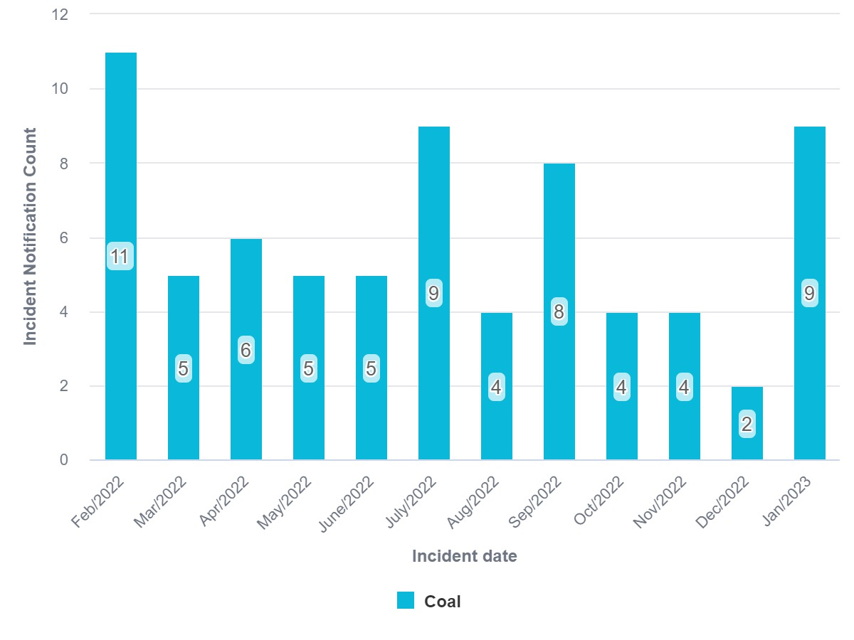
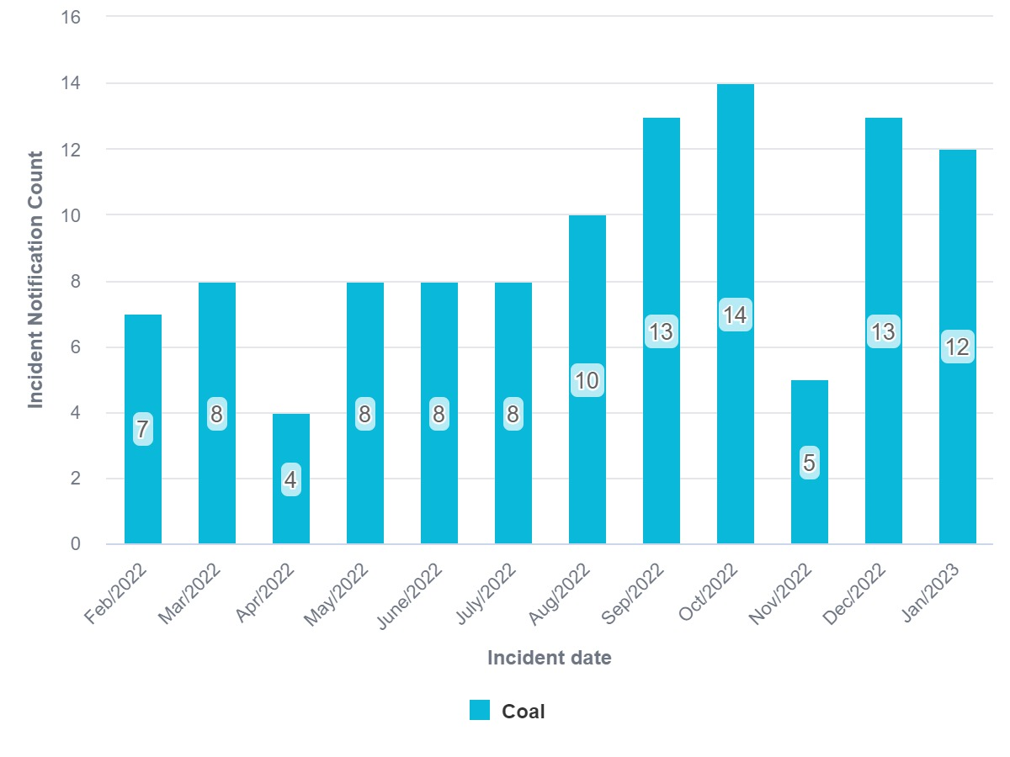
Incidents involving failure of Ex – Last 12 months
CHOOSE A SLIDE STYLE FROM
Home tab
New Slide
Choose layout
If layout goes awry, select Reset
TEXT
There are 5 levels of formatted text available.
Please move between text levels using the increase/decrease button on the menu above.
CHANGE SLIDE BACKGROUND/COLOUR
Design Menu
Format Background
Select colour from palette OR
Picture or Texture Fill
Find image
REPLACE IMAGE IN SHAPE OR ON PAGE
Right click on image
Change Picture
Select your image
OR
Delete the image
Click on icon
Find the new image
TO REPOSITION IMAGE WITHIN SHAPE
Click on image
Picture Format menu
Click on Crop button dropdown
To fit the whole image inside select FIT
To use only a portion select FILL then crop, move or resize image to show properly within shape.
ADD/CHANGE FOOTER
Insert Menu
Header & Footer
Tick to activate/Untick to remove
Change text
Failure of ex DES – 72 incidents
Failure of ex Electrical – 110 incidents
Notes:
No real improvement in failures of explosion protected equipment.
It appears electrically there has been an increase in numbers.

Slide 20
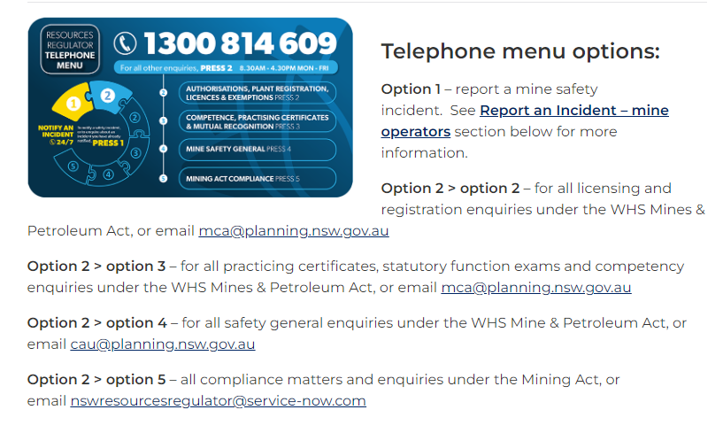
General enquiries or technical assistance
CHOOSE A SLIDE STYLE FROM
Home tab
New Slide
Choose layout
If layout goes awry, select Reset
TEXT
There are 5 levels of formatted text available.
Please move between text levels using the increase/decrease button on the menu above.
CHANGE SLIDE BACKGROUND/COLOUR
Design Menu
Format Background
Select colour from palette OR
Picture or Texture Fill
Find image
REPLACE IMAGE IN SHAPE OR ON PAGE
Right click on image
Change Picture
Select your image
OR
Delete the image
Click on icon
Find the new image
TO REPOSITION IMAGE WITHIN SHAPE
Click on image
Picture Format menu
Click on Crop button dropdown
To fit the whole image inside select FIT
To use only a portion select FILL then crop, move or resize image to show properly within shape.
ADD/CHANGE FOOTER
Insert Menu
Header & Footer
Tick to activate/Untick to remove
Change text
For enquiries to the engineering team either phone 1300 814 609,
or preferably email the Mining Competencies & Authorisations (MCA) at mca.regional.nsw.gov.au who will raise a request for us to get back to you
mca@regional.nsw.gov.au
mca@regional.nsw.gov.au
cau@regional.nsw.gov.au
Notes:
The RR technical assessor may contact the MCA to ask the applicant for additional information as part of the review process.
I know on some occasions when the review is getting close the RR technical assessor may contact the applicant directly to finalise items, but that is an exception rather than the rule.

Slide 22

Update to design and item registration guide
Ross Stutchbury
Senior Mine Safety Officer, Mechanical
9 March 2023
Notes:
Good morning everyone. For those who don’t know, my name is Jeremy U’Brien.
I am a Senior Mine Safety Officer working in the Mechanical Engineering Branch.
My duties include conducting technical assessments for design and item registrations.
***CLICK

Slide 23
Guide – Design and item registration
Extensive information is available on the Resources Regulators web site including
Guideline – Plant and item registration
Position paper – Fit form and function
Informative – eligibility criteria for design verifiers
Policy – Design registration
Notes:
Extensive information is available on the registration page on our web site.
I’m going to talk through the registration guideline and the verifier’s informative, Jeremy will talk about verification and the position paper for alternative parts. The registration policy is also published on our website for transparency.

Slide 24
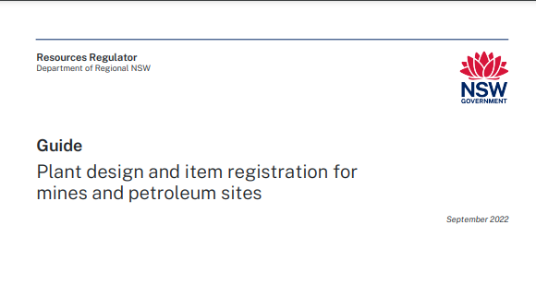
Where we left off at last forum
Guide – Plant and item registration for mines and petroleum sites has been published
Notes:
….If anyone is not sleeping well, I recommend the Registration guideline. A story of the relations of designers and verifiers; eligibility, duty, compliance and change.
I finished last forum saying - A new guidance document that covers the process of registration should be issued shortly and will replace the fact sheets that were on our web site. This has occurred. – September 2022
This document as suggested by the name is guidance. The guidance is reasonably extensive and should be reviewed by all parties involved with the registration process.
The guide has information of the process for designers, verifiers and applicants.
The information in the guide is a practical guide that allows parties involved with registration to meet the requirements of legislation
The information in the guide will streamline the application process if your application has accommodated the guidance provided.

Slide 25
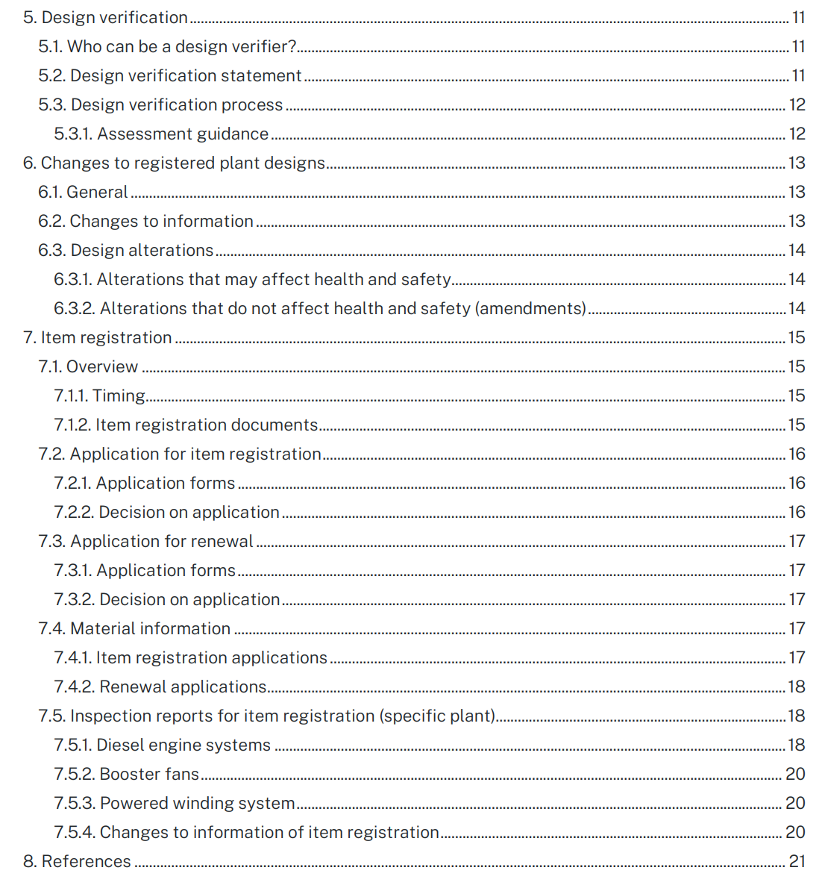
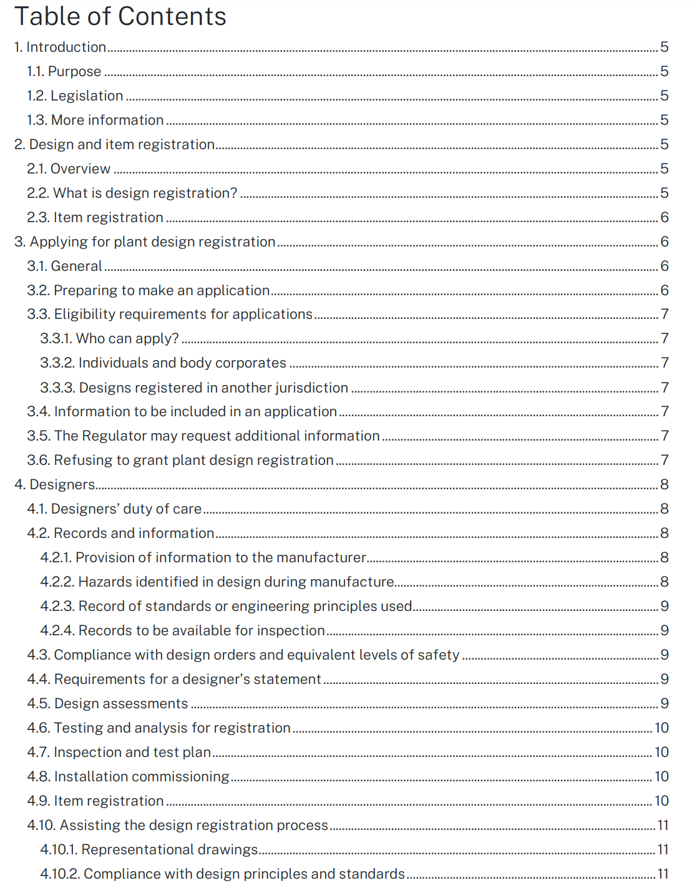
Contents
Introduction
Design and item registration
Applying for plant design registration
Designers
Design verification
Changes to registered plant designs
Item registration
Notes:
Registration can get complicated, the guideline has 21 pages of information.
I’d like to think that the information is concise and structured to be useful and informative. Some of you may have used it already, we are open to receive any feedback that you may wish to offer.
At the last forum I covered the duties of the designer and the additional requirements for records and information associated with registered plant. That information is in the guideline, and may help the designers amongst us with the structure of your work.
The guideline also reflects the simplification measures taken by the Regulator to allow for targeted alteration of designs

Slide 26
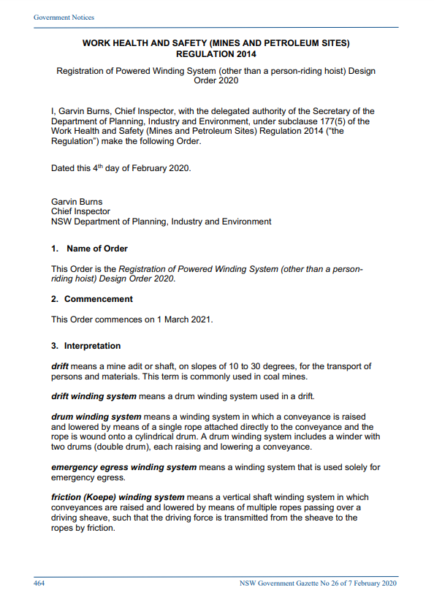
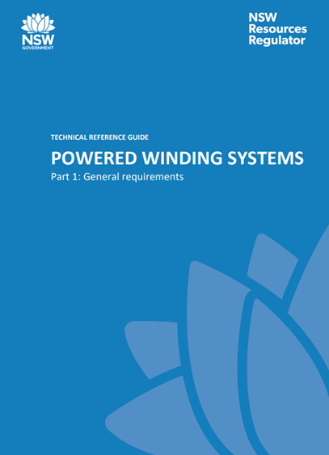
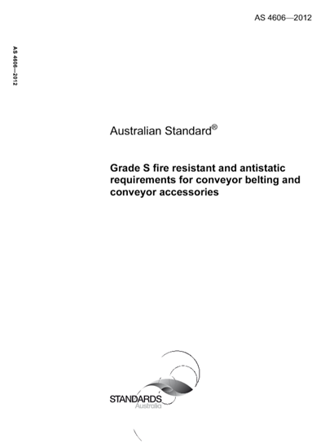
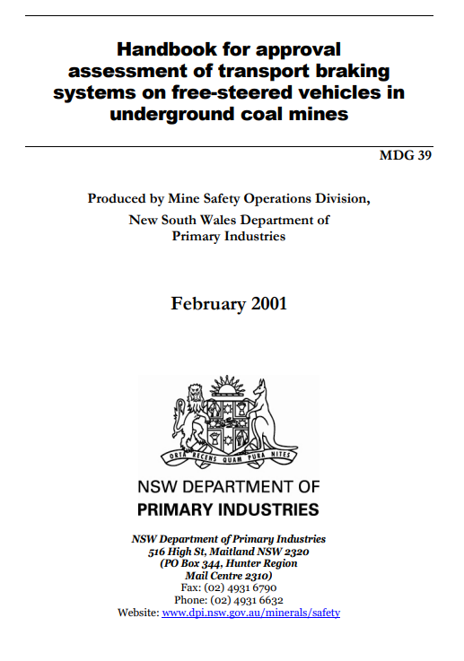
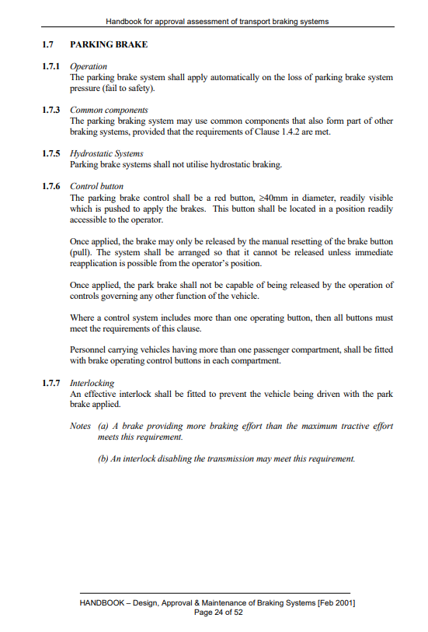
Department of Regional NSW
NSW Resources Regulator
Design Order – specifies parts of
TRG’s; MDG’s; Australian Standards
Notes:
This slide revisit the basics of the Design Order. Legislation give the regulator the ability to specify the standards for design registration. The regulator has for each type of design issued a design order. To register a design, the design must be compliant with the design order.
Recently issued design orders all have the same architecture.
Design orders typically call standards or parts of standards that have been developed through consultation with industry, manufacturers and experts in those fields. These standards address the safety and health risks for that plant.
Design requirements, testing and performance parameters have been written into Australian Standards, MDG’s and technical reference guidelines.
Each design order has an instrument to allow for the establishment of an equivalent level of safety where a prescriptive design requirement is not directly met. This instrument generally only applies to design requirements, no to test or performance requirements.

Slide 27
Guide – Design and item registration
Design orders
Provisions of the design orders now allow for targeted alterations where the focus is on the change.
Any change, and effected parts must comply with the new design order
The remainder of the design must be assessed and continue to comply with the existing registered design
This provision simplifies the alteration process
Notes:
Provisions of the new design orders now allow for targeted alterations where the focus is on the change.
Any change, and effected parts must comply with the new design order
The remainder of the design must be assessed and continue to comply with the existing registered design
This provision simplifies the alteration process, it is anticipated that there will be a much clearer and achievable path to accommodate changes by the alteration pathway.
The new registration guidance document covers the new design orders including alteration and amendment of designs.

Slide 28
Alteration – A change that may affect health and safety
Department of Regional NSW
NSW Resources Regulator
To assist with deciding if your change requires the process of an alteration, consider the following:
If the change to the design affects areas of the design that have design requirements, tests or performance parameters that are specified in the design order or the standards called by the design order, then the change may affect health or safety.
If you have carried out analysis to establish compliance to design order requirements or done performance testing to comply to design order requirements, then the change should be registered using the alteration process.
Notes:
To keep on with the alteration theme;
An Alteration is a change to a design that may affect health or safety.
Design orders call standards that relate to health and safety
If the change to the design affects areas of the design that have design requirements, tests or performance parameters that are specified in the design order or the standards called by the design order, then the change may affect health or safety.
If you have carried out analysis to establish compliance to design order requirements or done performance testing to comply to design order requirements, then the change should be registered using the alteration process.
This is a good place to start when determining the best process to manage a change to a design registration.

Slide 29
Guide – Design and item registration
Changes to registered plant design flow chart
A flow chart has been developed to reflect the process set by legislation
WHS parent legislation sets out the process for registration and registration changes
Notes:
It is anticipated that a new flow chart will be developed and added to the guideline.
This chart has not been published yet and is subject to change.
The chart is intended to show broadly the pathways for design and item registration that is laid out by the WHS legislation.

Slide 30
Registration specific design
Design process
The design process is essentially the same, however:
Documentation and records must be made, kept and available for inspection
The standard is specified by the Regulator (Design Order)
Verification of the design is required
The design must be registered with the Regulator
Notes:
But before we have a preview of the flow chart I wanted to revisit the difference between regular design duties and design duties for registered plant.
For regular plant, the duties of a designer are laid out under section 22 of the WHS Act.
The designer must
identify the purpose of the design
Carry out or arrange to carry out calculations, analysis, testing and inspections to ensure that the plant is safe to operate
And provide conditions or limitations for safe use
Provide information to flow down through manufacturer, supplier and user.
For plant that must be registered, the legislation has additional duties
The designer must make records and information of
The method used to determine the control measures
Records of standards or engineering principles used
And make the records available for inspection, including to the design verifier.
These requirements are outlined in the registration guideline.
For a registered design the regulator has determined the standards that must be met. The designer may comply with other standards, but must show compliance to the design order.
A registered design must be verified to comply with the design order by a person competent as a designer.
The design must then be registered with the regulator. The information provided and representational drawings are used to identify the design that is registered.
Essentially the registration process does not change the design process but requires verification and visibility of records.

Slide 31
Notes:
This is a preview of a yet to be published flow chart. The chart is intended to reflect the legislated registration process including how to manage changes to a registered design.

Slide 32
Who can apply for a change
249 Who can apply to register a plant design
A person conducting a business or undertaking that designs an item of plant may apply to the regulator for the registration of the design of that item of plant
A person with management or control of an item of plant may apply to the regulator for the registration of the design of that item of plant
284 Amendment on application by registration holder
The regulator, on application by the registration holder, may amend a registration, including by amending the registration to vary or delete a condition of the registration.
Notes:
The chart starts of with the players that can make application for a registration
In the case of a change; If a design is altered, and the altered design may affect health or safety, the altered design must be registered. An altered design is essentially a new design. The designer, or the person with management and control of the plant can apply for registration of a design.
A person with management or control of the plant may be the manufacturer, importer, supplier, or user of the plant.
Only a person that is the design registration holder can make amendment to that registered design or that registration document.

Slide 33
Type of design change
244 Altered plant designs to be registered
If the design of an item of plant specified in Part 1 of Schedule 5 that is registered under this Part is altered, the altered design must be registered under this Part.
In this clause a reference to the alteration of a design is a reference to an alteration that may affect health or safety
Notes:
On the critical path of the flow chart is the determination of whether the change may affect health or safety. The designer should consider the design order, and the standards called by the design order. Where there are requirements for test, analysis or performance called by the design order or the standards called by the design order, the change may affect health or safety. In this case the alteration path way is used. Where the change does not affect health or safety, the amendment process may be required.

Slide 34
Alteration process
187 Registration of plant designs..
(5) The regulator may, by order published in the Gazette, specify standards for plant that is required to be registered, or the design of which is required to be registered, by subsections(1)-(3)
Notes:
Simplification of the registration process has been made to make the alteration process more targeted on the change, the complete design no longer is required to be brought to the current design order. Improvements can be made in a targeted manor.
Where a change to a registered design may affect health and safety, the alteration process sets out the path to registration.
The designer must comply with section 22 of the Act to provide safe plant.
The design must comply with the analysis, testing and performance requirements of the design order.
Records and information of the design must be made and presented to a design verifier
The design verifier must assess the designers information and find that the design is compliant to the design order.
The design must be registered with the NSW Resources Regulator.

Slide 35
Amendment process
282 Changes to information
(b) Any information referred to in clauses 250, 255(1), 266(1) withing 14 days after the registration holder becomes aware of the change
Notes:
In the case where it is determined that there is no affect on health or safety, but there is information or representational drawings changes, the following process is required.
The verifier should be consulted to support any claim that there is no affect to health or safety
Where there is a change to the representational drawing or the information that was submitted for design registration, the registration holder must advise the regulator of the change to the design (WHSR clause 282).
The amendment process is primarily for a change of information such as:
a change of the registration holder’s name
to vary or delete a condition of registration.
Change the registration notice where information previously supplied has changed.
An example may be the change of the engine sump design to suit a low height application. To include this option on the registration drawing will change the revision of the drawing. Note, there are no specific requirements for an engine sump called by the design order or the standards called by the design order. In such a change process, the designer must comply with their duty section 22, and must make records and information of the change given that the design is a registered design.
On application for amendment the regulator can amend the registration notice to reflect the change. The applicant should provide suitable records and information with the application to support the change.
In this case the registration notice will be re-issued with the same number but different issue date.

Slide 36
No affect
WHSR 230 Records to be available for inspection
A designer of plant must ensure that the records made under clauses 228 and 229 are kept available for inspection under the Act.
A designer of plant must ensure that the records made under clauses 228 and 229 are made available for inspection by the design verifier of the plant design
A designer of plant must keep the records made under clauses 228 and 229 for the design life of the plant.
Notes:
In the case where it is determined that there is no affect on health or safety, and no information or drawings of the registration change, the following process is required.
The verifier should be consulted to support any claim that there is no affect to health or safety
187 – provide information to the manufacturer
228 and 229 applies specifically to registered plant
228 Designer must make records and information
Method used to determine control measures, and the control measures determined
Information provided from designer’s duty Section 22 of the Act.
Information to the manufacturer (187)
Records of any hazards raised by the manufacturer and how they were addressed.
Examples
An equivalent part is used to replace a part that is no longer available. The part is not identified as safety critical and is not specifically identified on the representational drawings or the information supplied for registration.

Slide 37
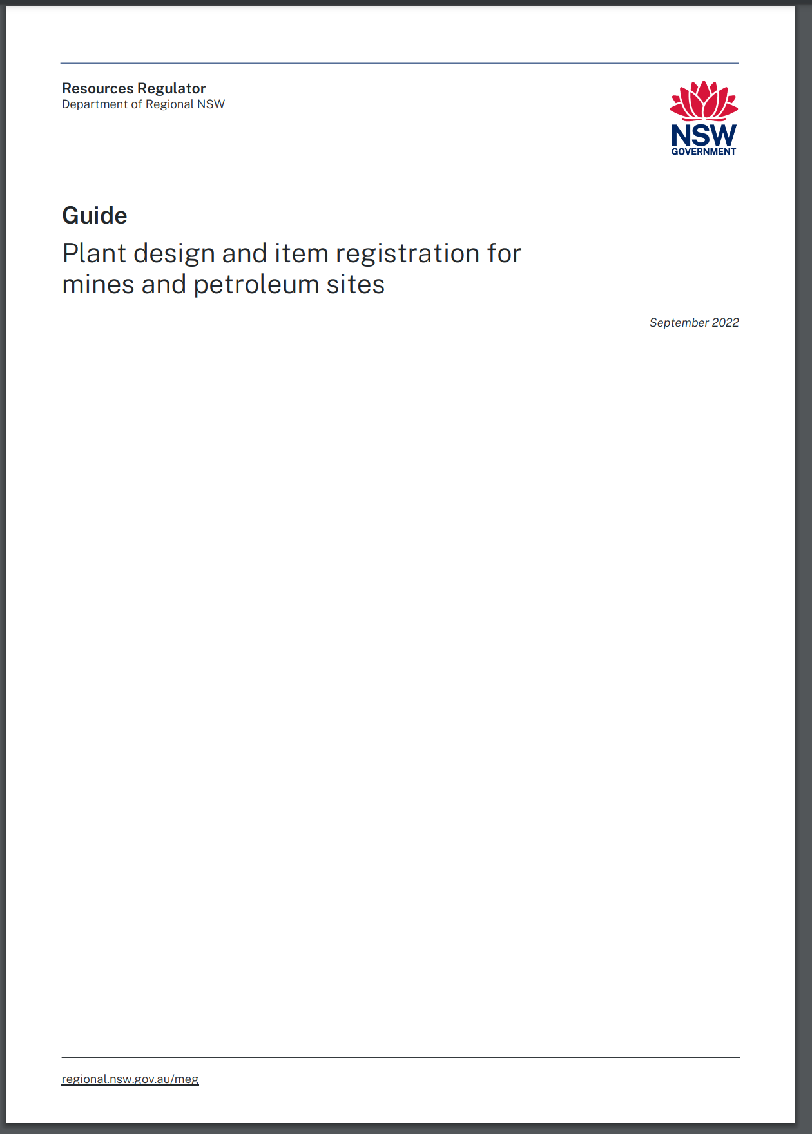
Guide – Design and item registration
Notes:
The expectation is that the guideline will be updated with some minor changes including a flow chart in the near future.
In the meantime please make sure you refer to the guideline when making application for design and item registration. The guide includes processes for new and renewal of item registration as well as new, alteration or amendment of a design registration

Slide 38
Plant Registration Forum
Use of Alternative Component parts &
Good practice for Design Verifiers
Jeremy U’Brien
Senior Mine Safety Officer, Mechanical
9 March 2023
Notes:
Good morning everyone. For those who don’t know, my name is Jeremy U’Brien.
I am a Senior Mine Safety Officer working in the Mechanical Engineering Branch.
My duties include conducting technical assessments for design and item registrations.
***CLICK

Slide 39
Introduction
Use of alternative component parts in design registered plant (fit form function)
Good practice for Verifiers
Notes:
My presentation today covers 2 topics
The first is about the “Use of alternate component parts in design registered plant”
This is a Position Paper that was released at the end of last year.
The second is about “Good practice for design verifier’s” where we will take a look at the design verification process including reports and so on.

Slide 40
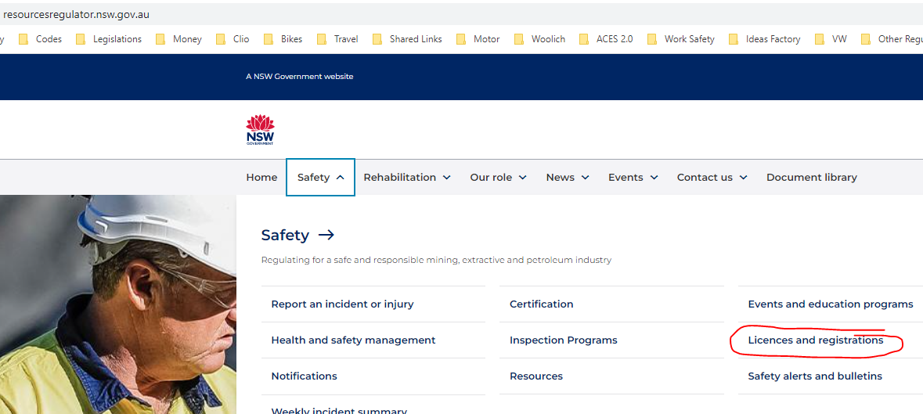
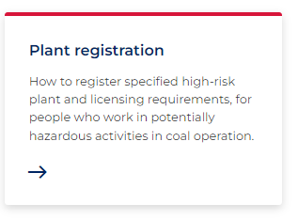
Guidance Material Location
Notes:
Just quickly to find it, GO TO:
https://www.resourcesregulator.nsw.gov.au/
Then click SAFETY then Licenses and registrations, then click Plant registration panel
CLICK

Slide 41
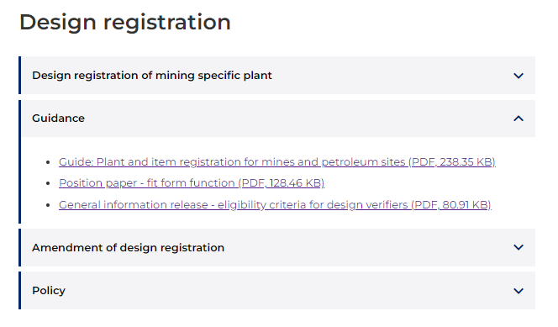
Guidance Material Location
Notes:
Then scroll down to ‘Design registration’ and expand the arrow at the end of the bar call Guidance,
There you will find:
the Fit Form Function Paper, as well as
The Guide for item and design registration and,
The Informative for Eligibility criteria for design verifiers
Now I don’t actually like this shortening the title to ‘Fit Form Function’ because it doesn’t accurately convey the intent of the paper as you will see.

Slide 42
Position Paper
Use of alternative component parts in design registered plant
Notes:
A alternate part in this context is a part which:
Is a single part or component
Does not require any assembly (but may require adjustment such as a valve).
Does not require any modification of the plant to install it.
Performs equal to or better than the original*
*short definition
Notes:
The way I have decided to approach this presentation is to run through the position paper and make comments along the way.
But to make sure we start off on the same page, I would just describe what is meant by an alternate component part.
In over-simplified terms it is:
A single part or component
That doesn’t require any assembly
That doesn’t require any modifications to install it
Performs equal to or better than the original
That is an abbreviated definition for simplicity at this stage.

Slide 43
Position Paper
Use of alternative component parts in design registered plant
Introduction
Mine operators or persons in control of design registered plant are responsible for maintaining the plant in accordance with its design registration, item registration (where applicable) and the manufacturers recommendations.
Circumstances may exist or develop throughout the operating lifecycle of design registered plant, where the use of alternate parts may be required for plant to remain operational or may present significant operational efficiency benefits.
The purpose of this position paper is to give practical guidance on the use of alternative component parts in design registered plant and the reasonable circumstances which should exist to justify the use of alternative parts.
Notes:
The position paper starts off with the introduction, which is.
READ PARAGRAPH 1
So - Generally speaking we know that plant is originally supplied compliant with the design registration and if is item registered is has conditions like
The plant must not be altered in a way that may affect its safety-related properties or is it outside of the plant design registration document
In addition to that, the plant must be maintained, inspected and tested in accordance with clause 213 which means basically in accordance with the OEM recommendations.
Paragraph 2 recognises there are some practical limitations to that.
READ PARAGRAPH 2
So we get to paragraph 3 which says
READ PARAGRAPH 3
Just to touch on what Greg mentioned earlier, we have made it easier for registration holders to maintain their registrations through the alterations process.
So the hope the OEM’s will use this process to ensure customers are well supported, but where the need arises, alternate components can be used.

Slide 44
Position Paper
Use of alternative component parts in design registered plant
Target Audience
In principle, this Position Paper has been develop for and is directed to mine operators and persons in control of plant subject to design registration.
Design registration holders, OEMs and other suppliers including recognised service facilities should also understand its intent.
To that end design registration holders should first and foremost follow the guidance for amendment or alteration in the Guide: Plant design and item registration for mines and petroleum sites
This paper is particularly relevant for mine operators with BF, PWS, and DES’s/ and TBS’s
This paper is not relevant for Conveyor Belt
It is not anticipated that it would be relevant for Gas Detectors, Detonators, Breathing Apparatus and CM Canopies if anyone still has these.
Notes:
In principle, this Position Paper has been develop for, and is directed to, mine operators and persons in control of plant subject to design registration.
Design registration holders, OEMs and other suppliers including recognised service facilities should also understand its intent.
BUT - to that end, design registration holders should first and foremost follow the information provided in the Guide: Plant design and item registration for mines and petroleum sites
This paper is particularly relevant for mine operators with BF, PWS, and DES’s/ and TBS’s
This paper is not relevant for Conveyor Belt
It is not anticipated that it would be relevant for Gas Detectors, Detonators, Breathing Apparatus and CM Canopies if anyone still has these.

Slide 45
Position Paper
Use of alternative component parts in design registered plant
Approaching a potential case for use of an alternate component part
Contact the OEM or design registration holder to ask if they have this alternate part or would consider making this part available through a registered design.
Otherwise, you will need to…
Understand how the alternate part may affect health and safety
Check if the circumstances are reasonable (next slide)
Review the applicable design orders and TRG’s to understand performance and testing requirements
Consider competent persons to do technical assessments and verification
Consider change management records, plant safety files, etc
Notes:
If a mine operator thinks there is a circumstance which exists and is beginning to consider use of an alternate part,
then the first thing they should do is READ SLIDE
FAILING THAT, you will need…..

Slide 46
Position Paper
Use of alternative component parts in design registered plant
Circumstances
If the alternative part has no requirement for testing, performance or analysis that is specified in the design order, or the standards called by the design order, or
where the component part, at the field replacement part level, is no longer available, has been superseded by an equivalent, or is otherwise discontinued, or
Is a consumable part
Notes:
Circumstances considered reasonable under which an alternate part may be used are;
1. If the alternative part has no requirement for testing, performance or analysis that is specified in the design order, or the standards called by the design order
An example of this is something like the oil sump of the engine. There is no specific testing for this component in AS3584.1 or .2.
2. Where the component part, at the field replacement part level, is no longer available, has been superseded by an equivalent, or is otherwise discontinued.
Example of this was a winder which required a joy stick controller which became UNOBTANIUM.
3. Is a consumable part
Examples of this could be fasteners of identical type and grade but from an alternate supplier, air filters or oil filters.

Slide 47
Position Paper
Use of alternative component parts in design registered plant
Assessment overview
Alternative parts must be adequately assessed by a person or persons competent to make such an
assessment. The assessment should ensure:
Appropriate circumstances exist for the use of the alternate part,
The alternative part can be fitted in place of the original part without modifications,
The performance of the alternative part is at least equal to the original part,
Any applicable performance and testing specified in a design order has been undertaken on the alternate part,
Any other calculations, analysis or testing consistent with the duties of a designer under the Section 22 of the Work Health and Safety Act 2011 has been performed and assessed, and
No new risks have been introduced by the alternate part.
Notes:
READ SLIDE
This should be fairly clear

Slide 48
Position Paper
Use of alternative component parts in design registered plant
A concept principally intended to assist mine operators and person in control of design registered plant make an initial assessment of suitable alternate parts is the fit form function (FFF) concept.
Fit-form-function – A concept where an alternate part is used in place of the original part which fits in the same location without any other modifications, performs the same function as the original, and provides an equivalent standard of performance as the original across the same range of operating conditions, without introducing any additional risks to health and safety.
It should not be interpreted that the FFF concept extends beyond replacement parts to subassemblies, sub-systems or other (broader) alteration concepts.
Site change management protocols should be used for the introduction of alternate parts.
Engineering files of the evidence used in the assessment and the results of that assessment should be kept. Plant safety file records and maintenance management systems should also be updated to reflect the changes made.
Notes:
Part of the assessment overview was the defining of Fit-Form-Function as a concept to ASSIST mine operators get to terms with potential use of alternate parts.
So the definition is…
READ THE SLIDE

Slide 49
Position Paper
Use of alternative component parts in design registered plant
Take aways
The use of alternate parts is perhaps not the preferred option but it is an option.
The process is open to mine operators and persons with management and control of design registered plant as they are the risk owners.
The alternative part must perform equal to or better than the original, in the same range of operating conditions, without an increased risk to health and safety.
Alternate parts must fit without modifications.
Reasonable circumstances for use of an alternate part are that the original part is:
does not have specific testing requirements under the design order,
no longer available, or
a consumable.
Notes:
So the take-aways for the Position Paper or the main point I wanted to get across were:
READ THE SLIDE

Slide 50
Position Paper
Use of alternative component parts in design registered plant
OEM’s should ensure design registrations are maintained and parts are predictably available.
The new design orders have been developed to make this process easier than before.
There are example questions in the Position Paper.
There is an assessment process in the Position Paper.
After following the process, if you still have questions or concerns, please email your question to MCA@regional.nsw.gov.au for a considered response.

Slide 51
Good practice for Verifiers
Design verification process
    Guide: Plant design and item registration for mine and petroleum sites clause 5.3
    It contains legislative requirements
    It contains advice or guidance for:
        what a verification report should include
        how to approach the assessment
        how to assess if a suitable equivalent level of safety has been established
        Assessment of changes that occur to the design during the testing phase and the adequacy of the final inspection and test plan (fixed plant)
Notes:
Next topic….. Good practice for Verifiers
Section 5.3 of the guide for Plant Design and Item Registration is called ‘Design verification process’
It contains legislative requirements, and
It also contains advice or guidance for:
> what a verification report should include
> how to approach the assessment
> how to assess if a suitable equivalent level of safety has been established (which may be changing slightly)
> Assessment of changes that occur to the design during the testing phase and the adequacy of the final inspection and test plan (fixed plant)
This is all good stuff and I want to touch on a few elements.
I want to apologise in advance for the fact that some of this part of the presentation may seam a little disjointed but I think by the end you will understand point I am trying to make.

Slide 52
Design verifiers and good practice
Duty of the verifier
    A design verifier of the design of an item of plant must document the design verification process carried out by that person and the results of that process.
    High Level
    Record when you were selected as the design verifier
    Record the date and details of; phone calls, emails, receipt of information, site visits, meetings, tests or demonstrations witnessed, draft reports released, revisions etc
    Low Level
    Record what you did to satisfy yourself for each individual clause
    WHY?
    Detail shows diligence on behalf of the verifier.
    Builds a sound record
Notes:
A design verifier MUST DO 2 THINGS:
They must document the design verification process and,
They must document the results of that process.
The verification process is what you did – at each step to do the verification.
The result is what decision you made – at each step in the verification.
So at a high level, there is the broad detail of what you did. To do this you can keep records of your activity and involvement in project as the verifier.
Use a table showing a date and activity undertaken from the first time engaged
Record the date and details of; phone calls, emails, receipt of information, site visits, meetings, tests or demonstrations witnessed, draft reports released, revisions etc
At the lower level, its recording the way you assessed each clause and how you verified the designers claim of compliance.
I will talk more about this later
I think, detail shows diligence on behalf of the verifier and builds a record you can come back to.

Slide 53
Design verifiers and good practice
Mindset
    It is not the job of the verifier to determine if something is compliant.
    It is however the job of the designer to state their claim and support it.
    The designer may claim the design:
        Complies, or
        Complies through an ELOS, or
        The requirement is not applicable to this design
      The designer should provide sufficient supporting evidence to support the claim.
Notes:
I was in some ICAM investigation training a couple of weeks ago.
And they used this Fishbone style diagram.
And I couldn’t quite get the jist of what the teacher was thinking in order to get to the causes or causal factors.
I wanted to know what was his mindset to approaching the Fishbone diagram.
So here are a few dot points to bear in mind when approaching the task of design verification.
READ THE SLIDE

Slide 54
Design verifiers and good practice
Mindset
      Where the designer indicates:
      COMPLIES – There should be sufficient evidence to support direct compliance with the Design, Performance or Test requirement of the Design Order or reference standard.
      Where the designer indicates:
      COMPLIES by ELOS – There should be sufficient evidence to support compliance to other published standards, engineering principles and/or risk controls consistent with the hierarchy of risk controls (Elimination, Substitute, Isolate, Engineering Controls, Admin, PPE).
      Where the designer indicates:
      NOT APPLICABLE – Clear and logical reasons as to why this requirement is not applicable to their design
Notes:
READ THE SLIDE

Slide 55
Design verifiers and good practice
Mindset
      It is then the verifiers task to make an assessment of the evidence provided, in order to form a view as to whether the claim is appropriately supported or not.
      If there is insufficient evidence to form a view, the verifier should seek additional information until satisfied they can agree or disagree with the designers claim.

Slide 56
Design verifiers and good practice
Report contents
    Identify the verifier and establish eligibility.
    Executive summary which summarise the RESULTS of your assessment.
    Provide an overview of the design being verified. This may include a word description of the plant such as basic features and performance characteristics, a photo or extract of a GA drawing.
    Design order review (the low level process)
    TRG or AS review (the low level process)
    Reference document list
    Statement of compliance to the design order. Note any requirements where an equivalent level of safety was used in lieu of direct compliance.
    A diary or table of main events in the process (the high level)
Notes:
So clearly this is just advice. The report format is up to you. This is just for your consideration but hopefully will make for a better quality record.
I will break some of these points down in a minute basically the report should……
I think about this as the tool to show the process and the results and build confidence that the verification has been undertaken correctly.

Slide 57
Design verifiers and good practice
Establish competence
    In the front of the verification report, include:
    A name and photo
    Qualifications
    Associations such as MIEAust, CP Eng, RPEQ etc
    Relevant work history and design experience or experience assisting other verifier’s
    Other details that may indicate relevant verifier’s knowledge such as standards committee memberships, or similar
Notes:
So to be a verifier you need to be competent. Ross talked about this before.
If we don’t know you we need to know who you are.
Do it once and you will have it for all your reports.

Slide 58
Design verifiers and good practice
Not involved with the design
    When you were appointed as the design verifier?
    What process is in place to ensure that independence is maintained?
    Use eligibility informative note as a checklist
Notes:
The other element of eligibility is not being involved with the design.
It is important to establish this as well.
I would recommend including a paragraph or 2 detailing what processes were in place to ensure how your independence from the design was maintained so far as is reasonably practicable
It may help to describe when you were appointed as the verifier and to run through the checklist from the eligibility informative and note how any issues not in line with the guide were managed.

Slide 59
Design verifiers and good practice
Documenting the process of verification
    Verifiers must document the design verification process and, document the results of that process.
Notes:
We mentioned earlier that the verifiers have to document the process of verification.
It has been our experience that some verification reports are not documenting the process of verification, but rather are focussed on recording the results of the process.
And just to be clear, some do this well.
If I could put this another way, following even a minor incident some years down the track, and the incident investigation found that the design was not compliant to the standard in some way. Would you be able to read your own verification report and know, why you believed the design was compliant at the time?
The next few slides will take a look a documenting the process of the design order and the reference standards.

Slide 60
Design verifiers assessments
Evidence, references and logic for the decision by the verifier.
 |  | DESIGNER | VERIFIER
Clause | Description | Claim | C | C by ELOS | N/A | NC | Justification
 |  |  | X
 |  |  |  | X
 |  |  |  |  | X
 |  |  |  |  |  | X
Notes:
So most of you will be familiar with this format for a clause by clause assessment for a standard or design order.
This is not the only way to do it but this is A way to do it.
Obviously you have columns for
Clause
Description
Then I show here a column for the designer to insert what they claim their design has achieved or if it’s N/A perhaps.
Then the next group of columns are for the verifier to indicate what they believe has been achieved based on the evidence presented.
Hopefully the verifier agrees with the designer by the time it is submitted.
And finally, the Justification column which are the specific references to where the evidence is found and a logic for the decision made by the verifier.

Slide 61
Design verifiers and good practice
Design order review
Line by line review of the Design requirements and Performance and Testing requirements.
It must treat each sub section.
Typically the design order has broad requirements. The verifier should be able to show a broad but logical ‘justification’ which hits the key points for how you have reached your decision.
In your justification, imagine you need to explain it to someone who is not familiar with the design or standard
Identify the references including page numbers or a range of pages
Identify the key reasons are that drove your decision.
Notes:
Just to cover off the basics

Slide 62
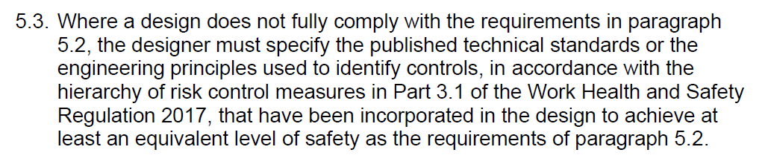
Design verifiers and good practice
If not used – State Not Applicable - All Design Order/TRG/AS requirements are complied with directly.
If used – Identify which Design Order/TRG/AS requirements are deemed compliant by ELOS
Clause 5.3.1 of the guide provides an approach to assess the appropriateness of ELOS
Discussed on the ‘Mindset slide’
Notes:
There is a clause like this in the design order that allows for the fact that the particular design may not be able to directly comply with a requirement.
This typically reads like….READ SLIDE
As the verifier performing a line by line assessment of the design order, when you get to this paragraph then
You need to state that it was not used or Not Applicable and that all requirements were complied with directly, OR
That compliance was achieved through an ELOS for these particular requirements and list the clauses of the relevant TRG or Standard that are appropriate.
We looked at this back on the mindset slide, but
Clause 5.3.1 of the guide provides some guidance for verifiers how to assess whether or not the designer has met the threshold for an ELOS.
The main points that should be covered off here are that:
Published standards, engineering principles used are identified and shown why they are suitable.
The hierarchy of controls has been used to treat the risk (elimination; substitution; isolation; engineering controls) over administrative controls and PPE.
That the risk control is equivalent to the TRG or standard. Ie at least the types of controls are used for the hazard
That an ELOS generally cannot be used for performance or testing requirements only design (feature) requirements.

Slide 63
Design verifiers and good practice
TRG or AS review – Justification Key Points
Identify key requirement (SAHR brake, min deceleration, delay time, etc)
Identify source of evidence (incl page no. or paragraph)
Show clearly how this meets the requirement
Other things….
Include assessments of the relevant Appendices. Testing has specific requirements.
Performance requirements must be measured.
Performance requirements are absolute.
Notes:
When you get down to the TRG review, and the justification, you should
READ FIRST 3 DOT POINTS
You do this anyway. That what the verification is. By recording your decision making process you are actually documenting the verification process!
OTHER THINGS…….
Examples in case you need it:
Speed be maximum within 10% or 2km/h
If 5 tests are required – Ensure the report has all 5 that pass.
Eg It is not sufficient evidence on the test report to write the time was <0.7s.

Slide 64
Example – TBS TRG
 |  | DESIGNER | VERIFIER
Clause | Description | Claim | C | C by ELOS | N/A | NC | Justification
1.3.4 | Stopping Distance – Service brakes | COMPLIES | C | - | - | - | [6] Brake test report pg 9 & 10 Calculated mean deceleration 0.237g (MIN). Result: Average result = 0.30g, all tests > 0.25g (fwd/rev) and greater than MIN.
Notes:
The justification here clearly shows, the verifier understood;
What was required
What the test result achieved was, and
How the design satisfied the requirement
Whereas tick – see brake test report doesn’t really document the verification process., it is merely the result.

Slide 65
Design verifiers and good practice
General notes – Applications
    Number all the submitted documents. 0. Application form – XYZ Hulk 10T Loader,
    Other documents 1, 2, 3, ………
    This makes referencing sources easier.
    Ensure document number and revision number are in the file name
    ALTERATIONS
    Make it clear what has changed.
    Provide before and after drawings with mark ups to show what changed (HIGHLIGHTER is good). This applies to representational drawings, schematics, and so on.
    If there have been changes that only affect a certain part of the design, then be clear about who assessed what parts are and are not affected, (the designer) and that the verifier has reviewed that assessment and agrees with the designer.

Slide 66
Thank you

Slide 67
Morning tea
Please return for session 2 at 10:20am
9 March 2023
Notes:
Good morning everyone. For those who don’t know, my name is Jeremy U’Brien.
I am a Senior Mine Safety Officer working in the Mechanical Engineering Branch.
My duties include conducting technical assessments for design and item registrations.
***CLICK

Slide 68
High Risk Activities
What is required for Winding systems and Booster fans
Owen Barry
Principal Inspector Electrical Engineering
9 March 2023
regional.nsw.gov.au

Slide 69
High Risk Activities - HRAs

Slide 70
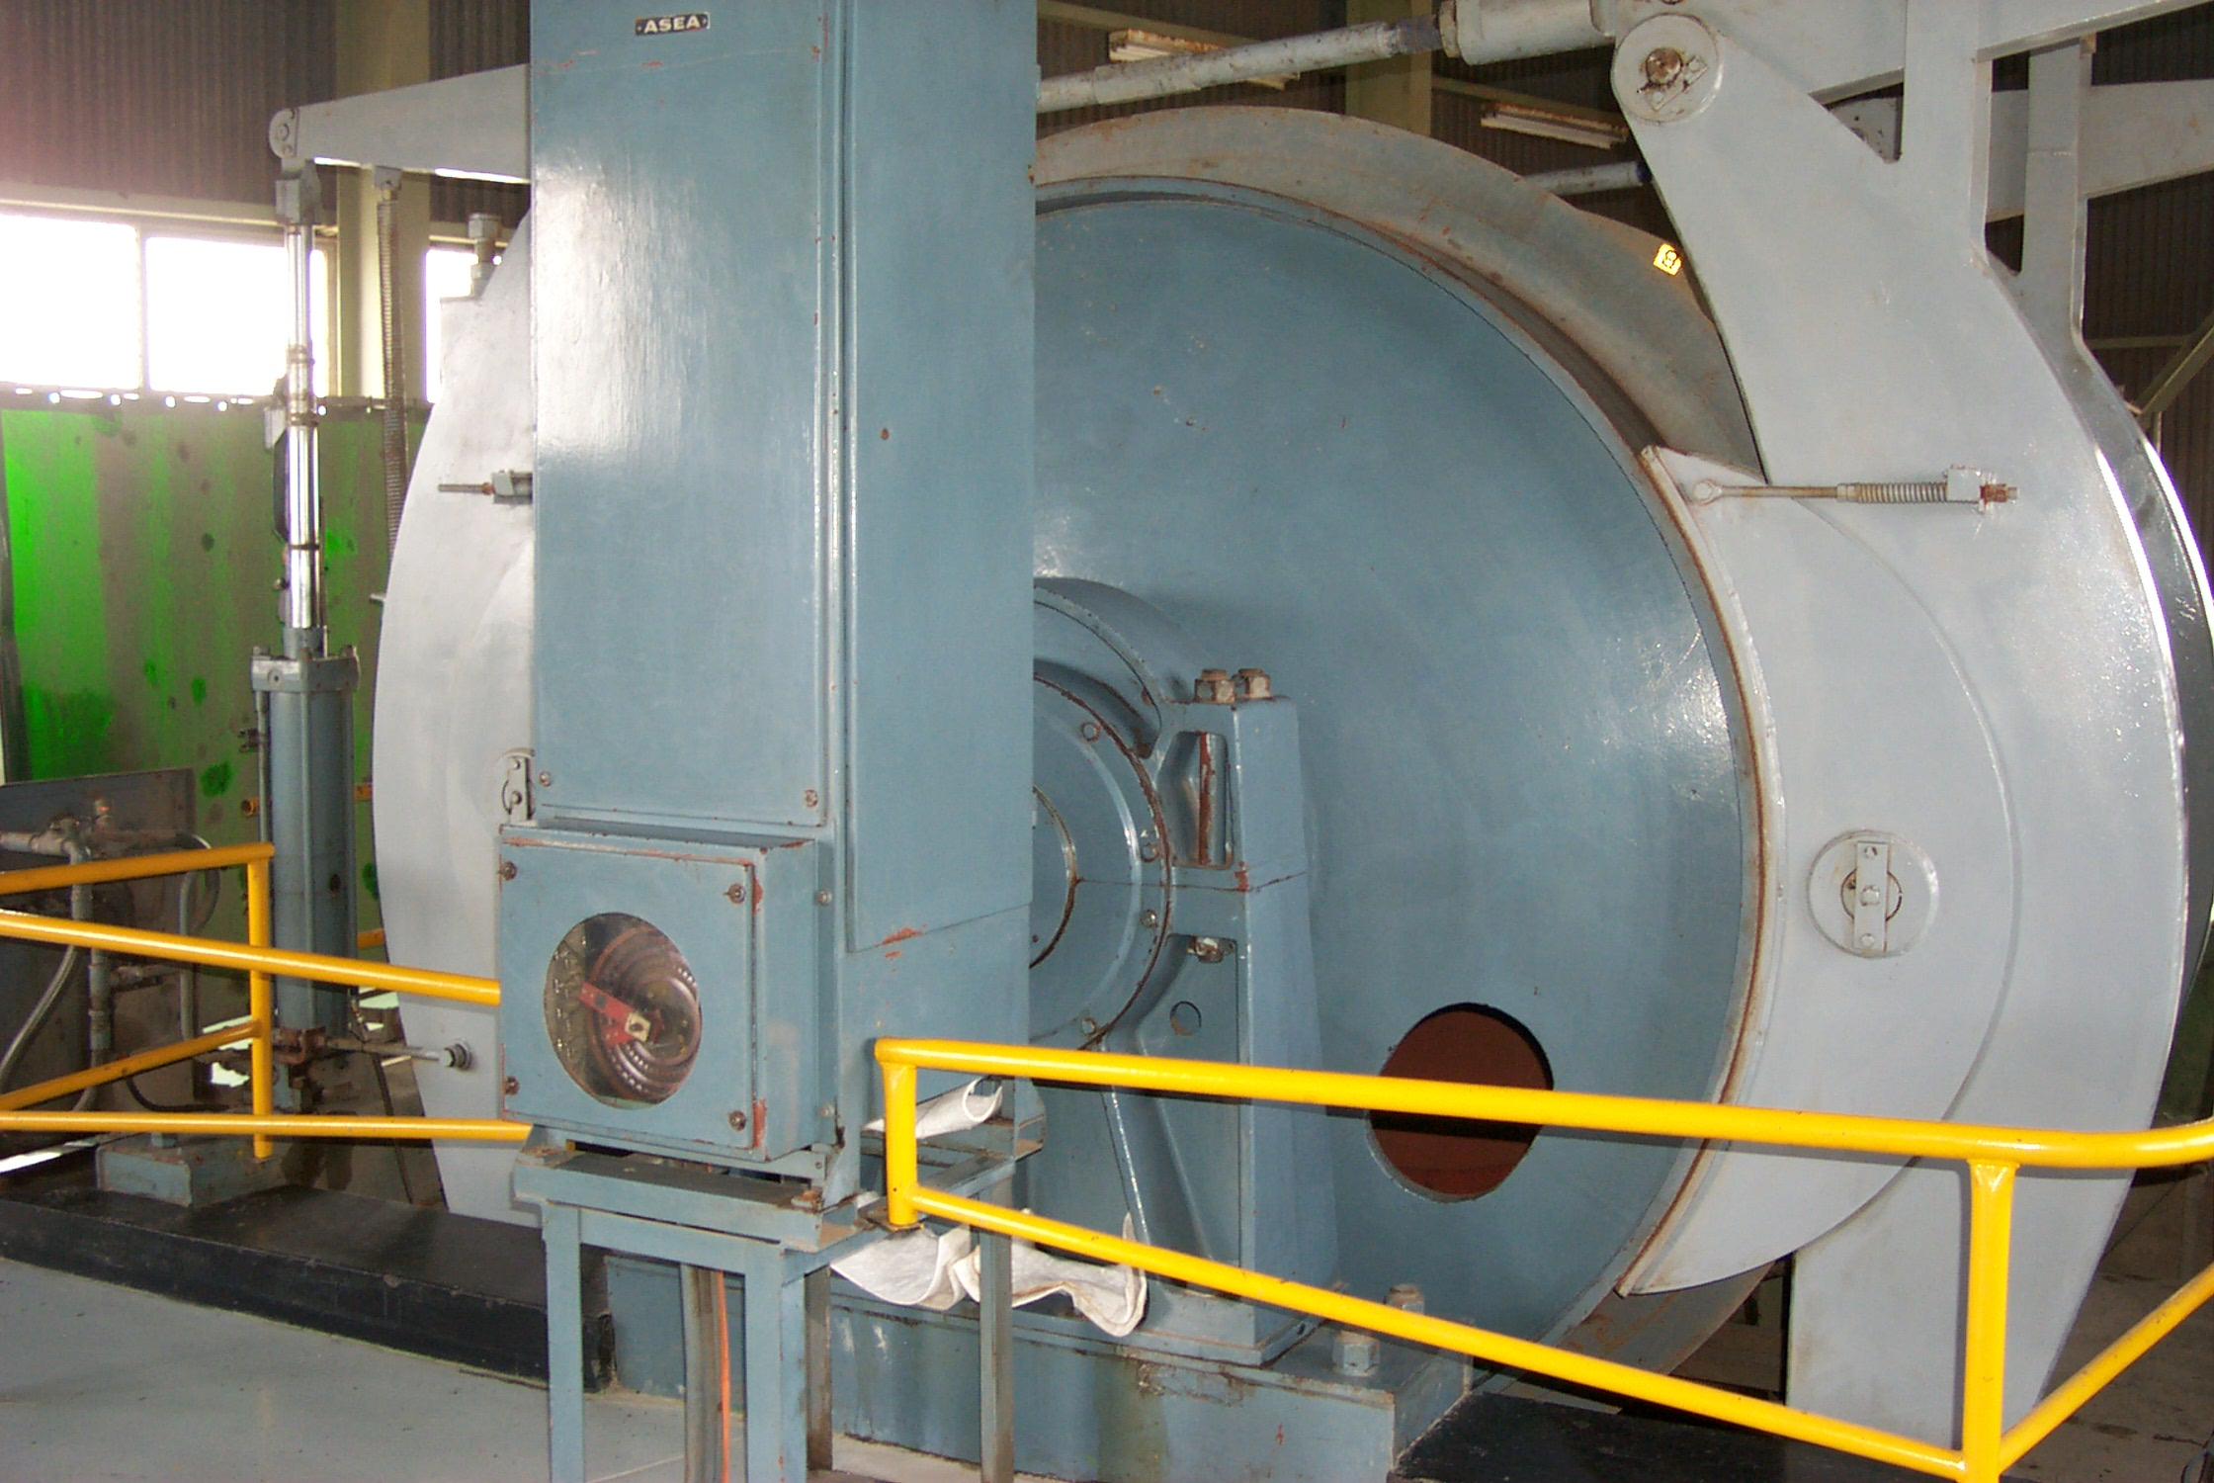
What are High Risk Activities?
Activities that have the potential for major safety implications
They require systematic and integrated planning to manage risks
  Can be managed in different ways
  Controls determined to suit the particular circumstances

Slide 71
High Risk Activities – What they are not
HRA notifications are not an approval
So what is the purpose?
A HRA notification gives the Regulator the opportunity to review:
the hazards and the risks identified,
the control measures to be used,
the methods identified to undertake the activity
It gives the Regulator an opportunity to intervene if the assessing inspector has concerns prior to the activity commencing

Slide 72
Who submits a HRA notification?
The operator of the mine or petroleum site
  Not the contractor
35 Notification of high risk activities
(1) The operator of a mine or petroleum site must ensure a high risk activity identified in Schedule 3 is not carried out at or in relation to the mine or petroleum site unless—
(a) the operator has given notice of the activity to the regulator, a

Slide 73
What if the HRA is not submitted?
The activity is not permitted to be undertaken
35 Notification of high risk activities
(1) The operator of a mine or petroleum site must ensure a high risk activity identified in Schedule 3 is not carried out at or in relation to the mine or petroleum site unless—
(a) the operator has given notice of the activity to the regulator, and

Slide 74
What happens once submitted?
Notification will be assessed
First question, has all information been provided
If not,
  Applicant may be requested to provide more information, or
  It may be deemed inadequate.
If deemed inadequate
  Notifier will be advised in writing
  Notification is taken to have not been given

Slide 75
What happens if adequate?
Once the waiting time identified in Schedule 3 has elapsed, the activity can be undertaken
The waiting period for commissioning of a winding system or a booster fan is 1 month.
The waiting period can be waived
  This must be requested by operator
  ISHR must be consulted (for a coal operation)
The waiting period can be extended
  Only when an operator amends a notice
35 Notification of high risk activities
(6) The regulator may waive or reduce the waiting period in relation to a particular high risk activity.
(7) A waiver or reduction under subsection (6) may only occur in relation to a coal mine if the industry safety and health representative who has been notified of the activity is consulted by the regulator in relation to the proposed waiver or reduction.
(8) A notice given to the regulator under this section may be amended by the operator giving further written notice to the regulator.
(9) The giving of a further notice under subclause (8) does not cause the waiting period to change unless the regulator extends the waiting period by a reasonable time to allow the regulator time to consider the notice as amended.

Slide 76
What if you don’t hear anything from the Regulator?
Once the nominated time period has expired, the activity can be undertaken
The activity must be done in accordance with the submitted notification
35 Notification of high risk activities
(1) The operator of a mine or petroleum site must ensure a high risk activity identified in Schedule 3 is not carried out at or in relation to the mine or petroleum site unless—
(b) the waiting period specified in Schedule 3 in relation to the activity has lapsed, subject to—
(i) a waiver or reduction of the period under subsection (6), or
(ii) an extension of the period under subsection (9), and
(c) the activity is carried out in the way specified in the notice, or in the notice as amended under subsection (8)

Slide 77
HRAs for Plant Registration

Slide 78
Notification of HRAs – Who and How
Notification is to be provided by the mine operator
Notification is to be entered through the Regulator portal
35 Notification of high risk activities
(1) The operator of a mine or petroleum site must ensure a high risk activity identified in Schedule 3 is not carried out at or in relation to the mine or petroleum site unless—
the operator has given notice of the activity to the regulator,
(2) The notice must be given in the approved way and form

Slide 79
Notification of HRAs– What
What is the activity to be undertaken
Specifics of what the activity is, and how it is going to be undertaken
Where is the activity to be undertaken
Additional information identified in Sch 3
The hazards identified for the activity
The assessment of risks for the activity
The relevant parts of the safety management system that describe:
  Systems
  Procedures
  Other control measures
(2) The notice must be given in the approved way and form and must include the following—
(a) the nature of the proposed high risk activity, including particulars of how the activity must be carried out,
(b) the proposed commencement date for the activity,
(c) the location of the activity,
(d) information or documents required by Schedule 3 in relation to the activity,
(e) the hazards identified as having the potential to arise from the activity,
(f) an assessment of the risks associated with the activity,
(g) the relevant parts of the safety management system for the mine or petroleum site that describe the systems, procedures, plans and other control measures that will be used to control risks to health and safety associated with the carrying out of the activity.

Slide 80
Schedule 3 – High Risk Activities
3 Winding systems
  the commissioning of a winding system in accordance with a design registered under this Regulation, section 187,
  the recommissioning of a winding system in accordance with an altered design registered under the WHS Regulations, clause 244.
25 Booster fans
  the commissioning of a booster fan in accordance with a design registered under this Regulation, section 187,
  the recommissioning of a booster fan in accordance with an altered design registered under the WHS Regulations, clause 244.

Slide 81
Winding systems – Additional information
What must be provided?
the name of the commissioning verifier for the commissioning of the winding system, and
a written statement signed by a commissioning verifier that states the commissioning plan for the winding system is appropriate
3 Winding systems
(3) The information and documents that must be provided in relation to the activity are as follows—
(a) the name of the commissioning verifier for the commissioning of the winding system, and
(b) a written statement signed by a commissioning verifier that states the commissioning plan for the winding system is appropriate.

Slide 82
Booster fans – Additional information
What must be provided?
the name of the commissioning verifier for the commissioning of the booster fan, and
a written statement signed by a commissioning verifier that states the commissioning plan for the booster fan is appropriate

Slide 83
Commissioning plan
commissioning plan means—
a plan that describes the process for commissioning or decommissioning the winding system or booster fan; and
prepared by the person responsible for the commissioning or recommissioning of the winding system or booster fan, and

Slide 84
Commissioning verifier
Must be a competent person
A person who has, through a combination of training, education and experience, acquired knowledge and skills enabling that person to correctly perform a specific task; and
is not involved in the commissioning or recommissioning of the winding system or booster fan

Slide 85
Questions???

Slide 86
Item registration
Ross Stutchbury
Senior Mine Safety Officer, Mechanical
9 March 2023
Notes:
Good morning everyone. For those who don’t know, my name is Jeremy U’Brien.
I am a Senior Mine Safety Officer working in the Mechanical Engineering Branch.
My duties include conducting technical assessments for design and item registrations.
***CLICK

Slide 87
Guidance document
Extensive information is available on the Resources Regulators web site including
Guide – Plant and item registration
Policy – Item of plant registrations

Slide 88
ITEM Registration
New items
Inspected by a competent person and assessed by that person as safe to operate.
Registration period is 5 years
Item registration renewal
Maintenance, inspection and testing must be carried out by a competent person -
In accordance with the manufacturer’s recommendations, if any, or
If there are not manufacturer’s recommendations, in accordance with the recommendations of a competent person
In relation to inspection, if it is not reasonably practicable to comply with paragraph (a) or (b), annually
Notes:
The purpose of item registration is to ensure that the plant is inspected by a competent person and assessed by that person as safe to operate.
After 5 years renewal will be required. If you get your application in before the registration expires, the plant remains registered until the regulator makes a decision on the renewal application. This does not apply to a new item registration. A new item must not go into service until the registration is issued.
Renewal applications must demonstrate that the plant has been maintained.

Slide 89
Item Registration
Inspection for registration
For the purpose of registration
By a competent person
Made at the time of registration application (say 3 months)
Provide material information
Notes:
An inspection of the plant as installed should be carried out for the purpose of registration, by a competent person.
Section 7.5 of the registration guideline outlines the requirements for item registration inspection.
This is not unlike a registration inspection for a on-road car.

Slide 90
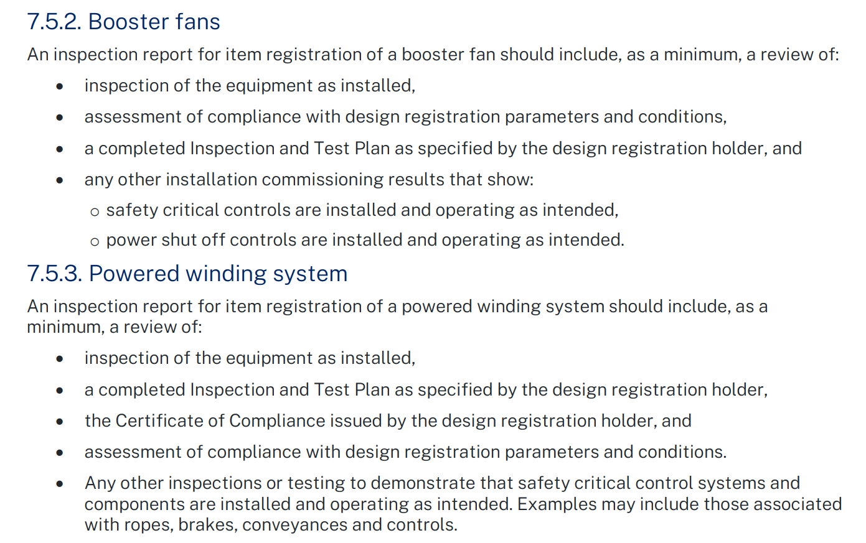
Notes:
For example for booster fans and powered winding systems the guideline sets out requirement for inspection reports.
I would recommend that the report include:
Identification of the plant
Description of main parameters, features, safety functions and limitations
Photos of the installation
Report observations from the inspection
Reference the design registration representational drawing
Reference the design registration notice
Reference the certificate of compliance issued by the registration holder
Reference the designer’s completed ITP as verified
Reference reports that was generated for the installation and commissioning

Slide 91
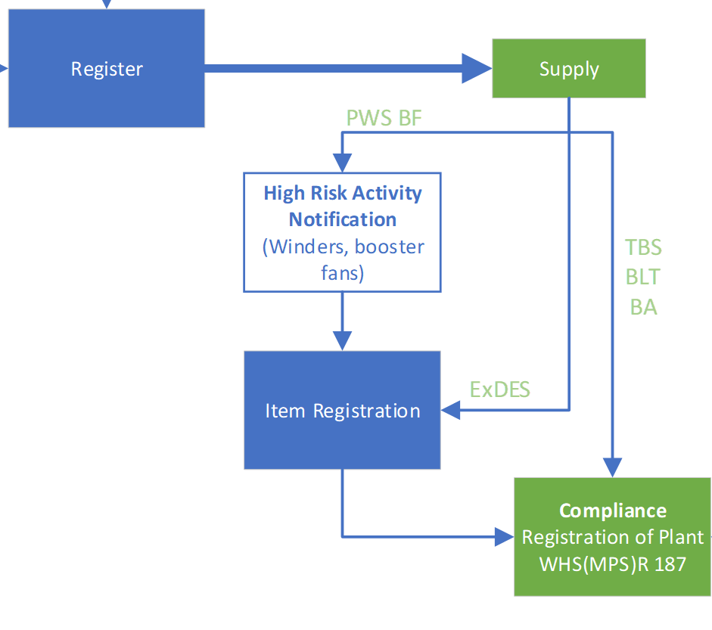
High risk activities
Winders and Booster Fans high risk activity
Commissioning in accordance with a registered design
Re-commissioning in accordance with an altered design registration
Commissioning Plan
Commissioning plan must include requirements of the design registration holder and be verified by a competent person who is not involved with the commissioning.
Notes:
High risk activity notification has been introduced to the commissioning and re-commissioning of winders and booster fan installations.
The commissioning plan must include the requirements of the designer’s commissioning ITP such that the design registration holder is in a position to issue a certificate of compliance once completed.
The commissioning plan may contain other information associated with the safe installation and commissioning of the plant.

Slide 92
Process for Item registration – Winder, Booster Fan
Notes:
The top schematic shows the previous registration process for design and item registration relating to booster fans and winders.
The bottom schematic shows the simplified process where design registration can be achieved based on a design. For a vertical shaft winder there are 280 pages of technical information that must be assessed and verified. This process, and any back and forth with the regulator can be completed before the commissioning of the winder.
Item registration carries over the designer’s ITP for verification of the installation of the design.
Application for item registration can be made. Typically this is a simple process given any questions relating to design registration have already been completed.
The time between commissioning and being placed into service is expected to be much quicker.

Slide 93
Process for Item registration – Winder, Booster Fan
Notes:
Looking in more detail:
The designer’s ITP is verified by the design verifier at the time of design registration
Design registration is granted
The plant can be supplied for installation
The mine must apply for HRA
For the HRA the commissioning verifier must verify the commissioning plan
Commissioning can be carried out under the HRA
Commissioning can be completed and verified by the commissioning verifier
The design registration holder can issue a COC on the basis of the completed ITP
Inspection for the purpose of item registration can be made
An application for item registration can be made with key information
Inspection report by a competent person
COC by the design registration holder
Verified completed commissioning plan
MIR can be granted
The plant can be placed into service

Slide 94
Inspection and test plan
Inspection and test plan
Confirm the functions, controls, operation of the design
Confirm the performance of the installation
Confirm operation of safety functions and components
Specify the acceptance criteria or tolerance for design, function and performance parameters
Specify testing, recording, witness and hold points, with preference for data logged records
Certificate of compliance
The ITP should be designed to provide information that would satisfy the designer for the purpose of product certification
A certificate of compliance should be issued by the designer that:
  identifies the design,
  specifies the published technical standards and engineering principles used in the design,
  identifies the purpose of the design,
  identifies calculations, analysis, testing and examination documents and reports, and
  Identifies the designer’s completed and verified commissioning inspection and test plan
  specifies the application and limitations of use of the design.
Notes:
Inspection and test plan
Confirm the functions, controls, operation of the design
Confirm the performance of the installation
Confirm operation of safety functions and components
Specify the acceptance criteria or tolerance for design, function and performance parameters
Specify testing, recording, witness and hold points, with preference for data logged records
Certificate of compliance
The ITP should be designed to provide information that would satisfy the designer for the purpose of product certification
A certificate of compliance should be issued by the designer that:
identifies the design,
specifies the published technical standards and engineering principles used in the design,
identifies the purpose of the design,
identifies calculations, analysis, testing and examination documents and reports, and
Identifies the designer’s completed and verified commissioning inspection and test plan
specifies the application and limitations of use of the design.

Slide 95
Inspection for the purpose of registration
Inspection report
The purpose of the report is to demonstrate:
an inspection has in fact taken place,
the inspection was undertaken by a competent person, and
the assessment by the competent person is that the plant is safe to operate.
Contents
Document site inspection, photograph
Review of installation
Review/compendium of documentation including
  Certificate of compliance issued by the registration holder
  Reference to Safety file and reports
  Completed inspection and test plan
Make assessment that the plant is safe to operate
Notes:
Inspection report
The purpose of the report is to demonstrate:
an inspection has in fact taken place,
the inspection was undertaken by a competent person, and
the assessment by the competent person is that the plant is safe to operate.
Contents
Document site inspection, photograph
Review of installation
Review/compendium of documentation including
Certificate of compliance issued by the registration holder
Reference to Safety file and reports
Completed inspection and test plan
Make assessment that the plant is safe to operate

Slide 96
Process for Item registration – Winder, Booster Fan
Notes:
This slide looks at the people involved with this registration process.
The designer to prepare an ITP during the design registration process
Once commissioning is completed the designer can issue a certificate of compliance for the design

Slide 97
Process for Item registration – Winder, Booster Fan
Notes:
For the verifier
The designer and design verifier agree to a suitable commissioning ITP during the design registration process
The regulator can grant design registration
A commissioning verifier must verify the commissioning plan. The commissioning verifier may be the same person as the design verifier
Commissioning can be carried out under the HRA program
When satisfied, the commissioning verifier can verify the results of commissioning are in tolerance of the designer’s ITP

Slide 98
Provide information
Material information
Provide a copy of:
Application form
Inspection report from competent person
Certificate of compliance issued by the design registration holder
Commissioning report – completed, signed off and verified
Commissioning reports
  Designer’s inspection and test plan – winders and booster fans
  Code D examination – ExDES
  Emission test - ExDES
In addition to the above, the applicant should determine if other reports are required to be provided to support the application.
Notes:
Application forms will be revised to be more comprehensive in listing the material information required.
For winders and booster fans, the commissioning report is an important document to validate the design registration. This document should be supplied and verified to satisfy the parameters of the design, including function, performance, control, safety related functions.

Slide 99
Thank you

Slide 100
Questions

Slide 101
Verification informative
Ross Stutchbury
Senior Mine Safety Officer, Mechanical
9 March 2023
Notes:
Good morning everyone. For those who don’t know, my name is Jeremy U’Brien.
I am a Senior Mine Safety Officer working in the Mechanical Engineering Branch.
My duties include conducting technical assessments for design and item registrations.
***CLICK

Slide 102
Informative document
Extensive information is available on the Resources Regulators web site including
Eligibility criteria for design verifiers - Informative
Guide - Plant design and item registration for mines and petroleum sites
Notes:
The informative document published by the Regulator was developed in response to some ongoing concerns identified during the assessment of design registration applications, and to ensure that a consistent approach to verification process is adopted by both designers and verifiers.
The informative provides contextual information to assist designers and verifiers comply with legislative requirements.
The Design Guide also has information for verifiers that broadly states that the verifier must clearly establish their separation from the production of the design.

Slide 103
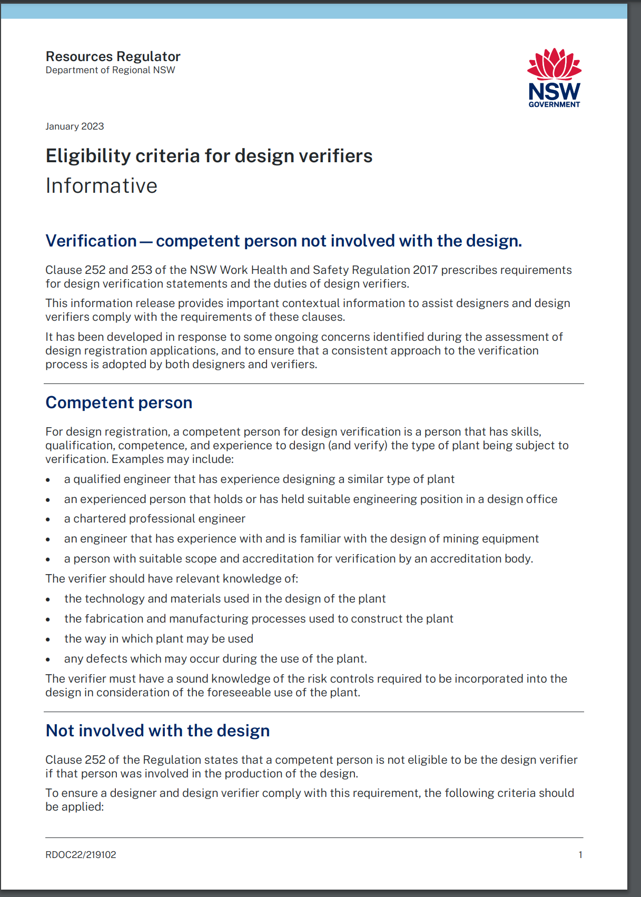
Design Verification
Competent person - designer
Not involved with the production of the design
Notes:
The eligibility criteria for design verifiers is set out in parent legislation WHSR 242. It calls for a competent person that was not involved in the production of the design.
This informative considers these requirements.

Slide 104
Competent person
A person that has skills, qualification, competence, and experience to design (and verify) the type of plant being subject to verification.
a qualified engineer that has experience designing a similar type of plant
an experienced person that holds or has held suitable engineering position in a design office
a chartered professional engineer
an engineer that has experience with and is familiar with the design of mining equipment
a person with suitable scope and accreditation for verification by an accreditation body.
Notes:
A competent person is defined in the WHSR for design verification under clause 252 as a person who has the skills, qualifications, competence and experience to design the plant or verify the design.
a qualified engineer that has experience designing a similar type of plant
an experienced person that holds or has held suitable engineering position in a design office
a chartered professional engineer – a chartered engineer has a code of ethics that restricts practice to areas of competence.
an engineer that has experience with and is familiar with the design of mining equipment
a person with suitable scope and accreditation for verification by an accreditation body.

Slide 105
Competent person
The verifier should have relevant knowledge of:
the technology and materials used in the design of the plant
the fabrication and manufacturing processes used to construct the plant
the way in which plant may be used
any defects which may occur during the use of the plant.
The verifier must have a sound knowledge of the risk controls required to be incorporated into the design in consideration of the foreseeable use of the plant.
Notes:
The verifier should have relevant knowledge of:
the technology and materials used in the design of the plant
the fabrication and manufacturing processes used to construct the plant
the way in which plant may be used
any defects which may occur during the use of the plant.
The verifier must have a sound knowledge of the risk controls required to be incorporated into the design in consideration of the foreseeable use of the plant
These items are broad descriptions of the type of knowledge that a verifier would hold, typical of a person who is a designer and has experience with the plant.

Slide 106
Not involved with the design
To ensure a designer and design verifier comply with this requirement, the following criteria should be applied:
The verifier should be independent of any parties involved in the design.
The verifier should not engage in any activities that may conflict with their independence of judgment and integrity in relation to their verification activities.
The verifier should not be a part of a legal entity that is engaged in design, manufacture, supply, installation, purchase, ownership, or use of the items verified.
Notes:
This criteria is drawn broadly from ISO/IEC 17020 – Conformity Assessment. While this standard is not prescribed in the regulation this standard provides a useful reference for competent persons who undertake inspection activities.
To ensure a designer and design verifier comply with this requirement, the following criteria should be applied:
The verifier should be independent of any parties involved in the design.
The verifier should not engage in any activities that may conflict with their independence of judgment and integrity in relation to their verification activities.
The verifier should not be a part of a legal entity that is engaged in design, manufacture, supply, installation, purchase, ownership, or use of the items verified.

Slide 107
Not involved with the design
The verifier should not be linked by means of the following to a separate legal entity engaged in the design, manufacture, supply, installation, purchase, ownership, or use of the items verified:
Common ownership, except where the owners have no ability to influence the outcome of the verification.
Common ownership appointees on the boards or equivalent of the organisations, except where these have functions that have no influence on the outcome of the verification.
Directly reporting to the same higher level of management, except where this cannot influence the outcome of a verification.
Notes:
The verifier should not be linked by
Common ownership, except where the owners have no ability to influence the outcome of the verification.
Common ownership appointees on the boards or equivalent of the organisations, except where these have functions that have no influence on the outcome of the verification.
Directly reporting to the same higher level of management, except where this cannot influence the outcome of a verification.

Slide 108
Not involved with the design
Where the above criteria cannot be met, a clear separation of the responsibilities of the verifier from those of the personnel employed in the design should be established by organisational identification and the reporting methods of the verifier within the parent organisation.
Notes:
Where the above criteria cannot be met, a clear separation of the responsibilities of the verifier from those of the personnel employed in the design should be established by organisational identification and the reporting methods of the verifier within the parent organisation.
This gives provision for an in-house verifier to establish how they are not involved with the design and requires organisational identification and reporting methods. This may show where the verifier sits in the organisational chart and the reporting structure that presents sufficient independence from the design. Note that this is a lower level criteria taken from the experienced inspection standard AS 17020.
Companies that carry out in-house verification should consider this informative information in a structured manor, and where applicable take measures to re-set.
Under the WHS Act, a ‘person’ may be an organisation or an individual.
Where a designer is a person representing an organisation (PCBU) and the verifier is a person representing the same PCBU, a claim that that person was not involved with the design would only appear somewhat valid if the persons are individuals.
Designers and verifiers should also consider the information from a perspective that the verifier in such a case is an individual person.

Slide 109
Not involved with the design
Notes:
When you are up close it may seem reasonable to declare that there was no involvement with the design

Slide 110
Not involved with the design – perspective view
Notes:
From a different perspective, such a claim may not be as clear.

Slide 111
Not involved with the design
Notes:
Who is your first pick for design verification?

Slide 112
Further guidance for verifiers
Verifiers cannot place themselves in the position of assuming any responsibilities of the designer. Verifiers should not:
  give advice to the designer as to the resolution of a compliance issue
  participate in risk assessments, FMEAs, functional safety assessments,
  provide design solutions or services relating to the design
  provide calculations, analysis, testing or examination that is arranged to be carried out by the designer to satisfy the designer’s duty (Work Health and Safety Act 2011 section 22)
  represent the interests of the designer, manufacturer, supplier, installer, purchaser, owner, or user. For example, contact the Regulator on behalf of an applicant for registration.
  Assess compliance on behalf of the designer (the designer must establish how compliance is achieved. The verifier must verify the designer’s claim of compliance)
Notes:
Here is some guidance for verifiers to assist with the verification process. It is important to not become involved in the design and it will take some rigor on the part of the verifier not to give direct advice.
We have received some applications where the verifier has done the calculations, analysis, risk assessments and testing.
Verifiers should not:
give advice to the designer as to the resolution of a compliance issue
participate in risk assessments, FMEAs, functional safety assessments,
provide design solutions or services relating to the design
provide calculations, analysis, testing or examination that is arranged to be carried out by the designer to satisfy the designer’s duty (Work Health and Safety Act 2011 section 22)
represent the interests of the designer, manufacturer, supplier, installer, purchaser, owner, or user. For example, contact the Regulator on behalf of an applicant for registration.
Assess compliance on behalf of the designer (the designer must establish how compliance is achieved. The verifier must verify the designer’s claim of compliance)
Facilitation of risk assessments such as functional safety AS 61508.1:2011 has specific requirements for level of independence (section 8) including warnings not to provide advice so as not to compromise their independence. It may be reasonable for the verifier to act specifically to the requirements of section 8. A declaration of that action should be made by the verifier.
ISO 13849, AS 4024.1503 does not seem to have a similar provision, the verifier should not facilitate.

Slide 113
Further guidance for verifiers
Verifiers should:
  act impartially
  advise the designer of the reason(s) for being unable to verify full compliance (if applicable)
  carry out calculations, analysis, testing or examination as required to verify the design
  for the purposes of verification, provide test, examination, documentation, witness, hold and record point requirements for the designer’s inspection and test plan
Notes:
The verifier should:
Act impartially
Advise the designer of the reasons for being unable to verify full compliance if applicable; without offering solutions
Carry out calculations, analysis, testing or examination as required to verify the design. This may be checking a calculation where the number may not look right, or examining a control circuit to understand the operation more clearly. This is typically to satisfy your understanding of the plant for the purpose of verification.
For the purposes of verification, provide test, examination, documentation, witness, hold and record point requirements for the designer’s inspection and test plan. This is for planning the verification, and the purpose of design registration verification. It may be that the verifier may wish to get a better understanding of the plant by witnessing some of the testing such as FAT or a vehicle brake test.
Note that the designer has the duty to carry out calculations, analysis, testing and examination (WHS Act Section 22). This work must be carried out, or arranged to be carried out by the designer. The verifier should not become involved with the design by doing this work for the designer. Arrangements to witness any testing can be made if required by the verifier.
For booster fans and winders, the designers commissioning ITP should be verified to include all necessary testing and inspections to confirm the installed plant complies with the design. The commissioning ITP should have the expected performance parameters and an acceptable tolerance for the results. For booster fans and winders, the commissioning ITP will be completed and verified for item registration.

Slide 114
Guide - Plant design and item registration
Notes:
The guideline for registration gives guidance on the process and requirements for verification. Once you are comfortable with your position to verify having considered the verification informative, please refer to the registration guideline for the process.

