Slide 1
Using Video Exposure Monitoring to Investigate Dust Exposures

Slide 2
Notes:
HVO had a SEG program from historically having a hygienist on site, SEG program has continued as a risk based monitoring program additionally to the legislative sampling. Lots of existing historical data
We could say, tyre fitters were identified as a high risk group. Exceedances had been identified.

Slide 3
Date | Task | Respirable Duct NOC | OEL | Silica, Crystalline, Quartz | OEL
25/07/2018 | Bolt on Wheels - Workshop; Clean and fit Pos 5 + 6; Pre-starts & General work - Tyre Pad; Job dockets & paperwork | 0.5mg/m³ | 2.86mg/m³ | 0.036mg/m³ | 0.095mg/m³
21/03/2019 | Unbolt & bolt & fit up wheels #34, Clean hub and rim using grinder | 4.5mg/m³ | 2.38mg/m³ | 0.0030mg/m³ | 0.095mg/m³
3/07/2019 | 463 Tyre Work on Pad, wire brush rim components; 479 Position 3 Tyre, working around forklift, wire brush to clean rims; 407 S&F Position 3&4, working around forklift, using of wire brush | 0.5mg/m³ | 2.38mg/m³ | 0.092mg/m³ | 0.095mg/m³
2/07/2020 | Clean rims with grinder (0.5hrs); Location: North Workshop; Duration: 0.5 hrs; Respirator: Yes Strip/fit Pos 5+6 tyres (2hrs), unload/load tyres (2hrs), fit wheels/tyres (2hrs); Location: Tyre Pad; Duration: 6 hrs | 0.3mg/m³ | 1.43mg/m³ | 0.035mg/m³ | 0.048mg/m³
7/06/2021 | Bolt on PO52, buff wheel and hub in Workshop; Tyre Pad unbolt/bolt PO53 983; Strip tyres off 810 in Workshop and Unload Tyres in Tyre area | 1.0mg/m³ | 1.43mg/m³ | 0.090mg/m³ | 0.048mg/m³
Notes:
HVO had a SEG program from historically having a hygienist on site, SEG program has continued as a risk based monitoring program additionally to the legislative sampling. Lots of existing historical data
We could say, tyre fitters were identified as a high risk group. Exceedances had been identified.

Slide 4
Limitations of Traditional Monitoring
Requires hygienists to interpret the data.
These results take approximately 4 weeks to be returned.
It only produces 1 result per shift.
The result provides little insight into what occurred during the shift.
Reliance on workers reporting activities and durations accurately.
Cannot measure task-based exposures effectively.

Slide 5
The Future of Exposure Control
Current State
Traditional exposure monitoring (SEGs)
Personal exposure monitoring based programs.
Broadly defined exposure elimination strategies.
Next Steps
Task/control focused solutions, including:
Task Assessment
Control Verification
Detailed and specific exposure elimination strategies.

Slide 6
Benefits of Real-time Monitoring
Benefits of real-time monitoring.
Site driven issue identification.
Real-time results, no waiting weeks.
Second by second analysis of measurement.
Provides exceptional detail on dust exposure during the measurement.
Can be used to measure tasks.
Notes:
Note limitations about comparison to exposure standards, precise but not necessarily accurate, cant measure RCS, etc…

Slide 7
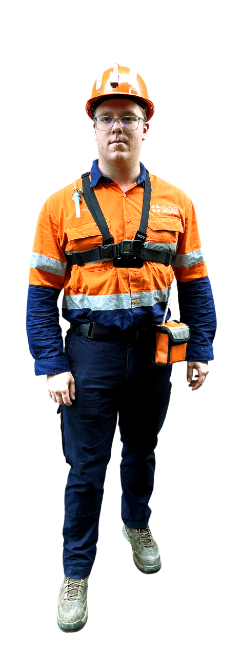
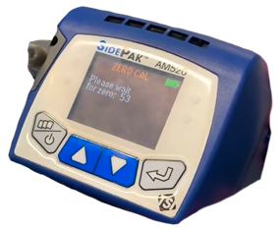
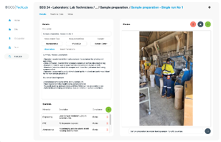
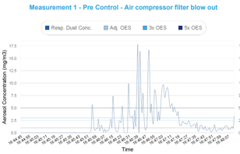
Exposi
Analyse
Respirable dust.
Compatibility
Portable real-time monitoring devices.
Video recorders + phones.
Outputs
Exposure profiles for tasks & SEGs.
Individual summary reports.
Visualisation of exposures.
Visualisation of controls.
Library of tasks.
Pre / Post control comparisons.
Real-time Device
(Optional) Video
Exposi
Reports / Videos

Slide 8
Step 1 – Task Assessment

Slide 9
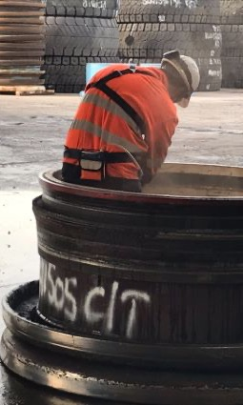
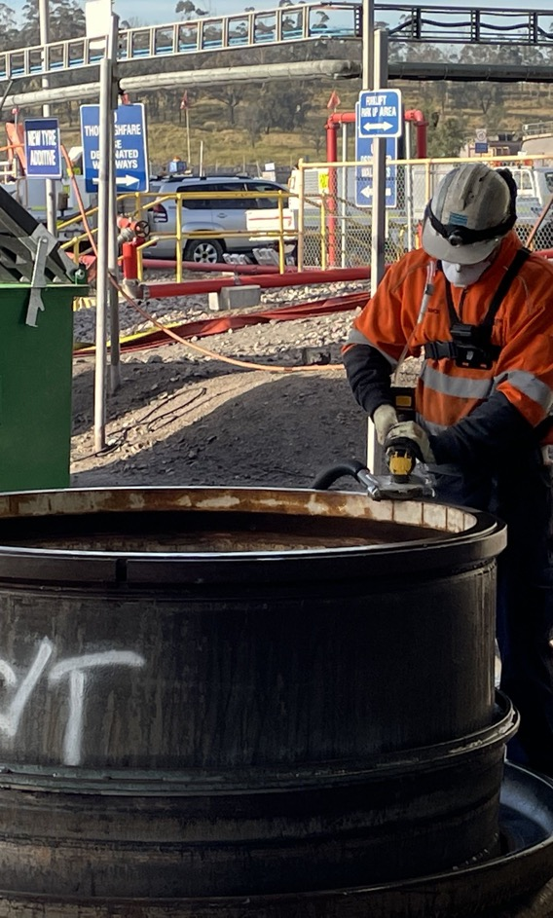
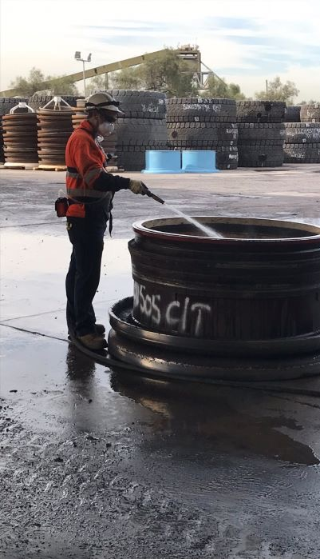
Pre Wash + Wet Grinding
Dry Grinding
On Tool Extraction

Slide 10
Step 2 – Implement and Verify Control Effectiveness

Slide 11
Feedback
Primarily, allowed identification of the high exposures resulting from this task when uncontrolled. Has helped proactively identify this task as an issue at other sites.
Allowed for effective visualisation and quantification of effectiveness for a selection of control options
Undertaking RTM + Go Pro is powerful & action provoking. It is beneficial to everyone involved in the process. Ensuring that the platform to showcase the outputs, and appropriately store the data is key.
It provided something more tangible than just data and promoted discussion and action.
This task had been investigated prior and no changes made. Changes have been implemented (improve fit for purpose buffing tool with LEV, PAPR) with continual conversation re: higher level controls i.e. water suppression.
Notes:
This unplanned realtime demonstration went all the way up the chain to the Executive General Manager for Yancoal and Glencore.
This put Lisa’s name and GCG’s name all the way up the chain.
They even allowed us to release the finding as a case study.

Slide 12
Notes:
Routine risk based program data to date. VEM and control work was undertaken in 2021, results since 2021 all <50% OES

Slide 13
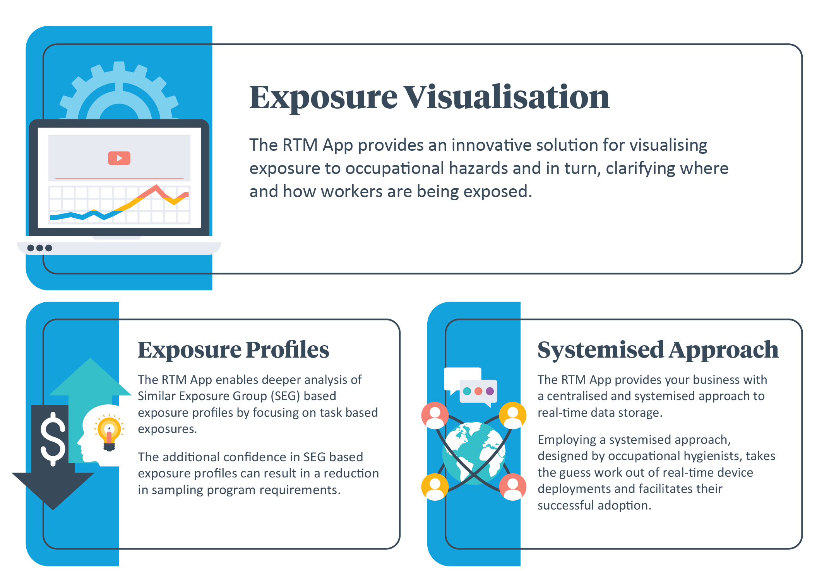
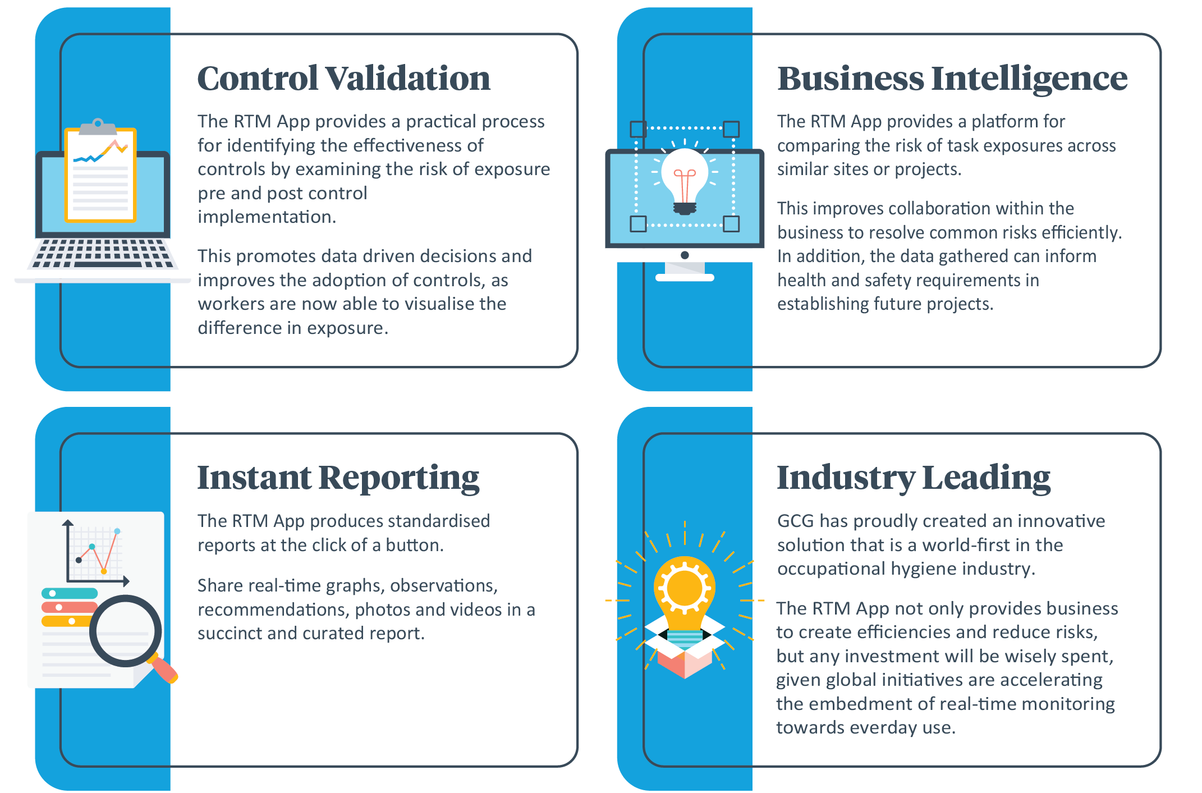
Exposi - Features and Benefits
Notes:
Routine risk based program data to date. VEM and control work was undertaken in 2021, results since 2021 all <50% OES

Slide 14
Exposi Enquiries or Demo
Simon Crane
Business Development Manager
E: Simon.crane@gcg.net.au
General Enquiries or Questions
Hamish Rae
Occupational Hygienist
E: Hamish.rae@gcg.net.au
M: 0476 606 039
Kristy Prior
Health & Hygiene Coordinator
E: Kristy.prior@hvo.com.au
Thank you

